Slide 1


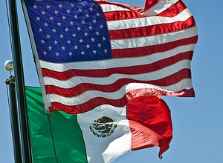
¿Donde estaba Waldo … Eh? Update on the Binational Case Variable and Communication Protocol
Gabriela Escutia, MPH; Katrin Kohl, MD, PhD; Ken Komatsu, MPH; Alfonso Rodriguez Lainz, PhD, DVM
CDC/CSTE
Applied Epidemiology Fellow
CDC Quarantine Station San Diego & U.S.-Mexico Unit
National Center for Emerging and Zoonotic Infectious Diseases
Division of Global Migration and Quarantine

Slide 2
Background: Binational Case Variable Definition per 2013 CSTE Position Statement
A data field would identify a case as binational when it meets one or more of the following criteria
Potentially exposed while in Mexico or Canada
Potentially exposed by a resident of Mexico or Canada
Resident of Canada or Mexico
Has case contacts in or from Mexico or Canada
Exposure to suspected product from Canada or Mexico
Other situations that may require binational notification or coordination of response (e.g., a measles outbreak without known cross-border contacts in a border community or state; exposure to an exported product from the U.S. to Canada or Mexico)

Slide 3
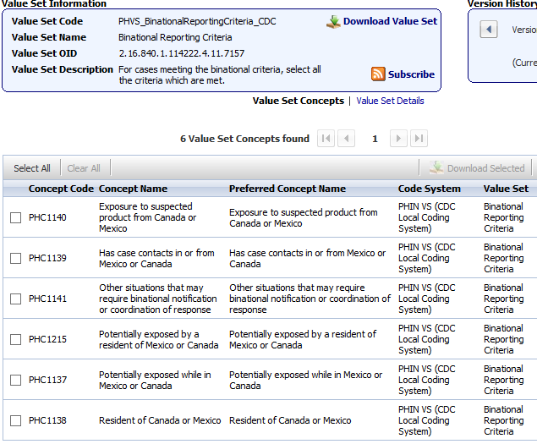
Background
2014 Changes to the National Notifiable Diseases Surveillance System ( NNDSS) based on the position statements approved by the Council of State
and Territorial Epidemiologists (CSTE) at their annual meeting in June 2013

Slide 4

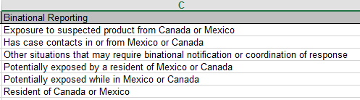
Background Binational Variable added to ArboNet April 2016*
ArbonetVer6Lookups2015.xls
* As USMU efforts around binational variable.

Slide 5
Background Binational Notifications by U.S. State and Jurisdiction, Pilot Dec 1, 2011 – April 30, 2016
 | Cases* | Clusters / Outbreaks | Total
Arizona | 1,131 | 4 | 1,135
San Diego County | 440 | 10 | 450
Texas | 38 | 5 | 43
New Mexico | 62 | 1 | 63
California† | 122 | 7 | 129
Other states (U.S.) | 68 | 11 | 79
Multi-state (U.S.) | - | 2 | 2
Total | 1,861 | 40 | 1,901
*Includes all reportable and non-reportable diseases, all outcomes
†Excluding San Diego County
Notes:
If an outbreak is reported and a case(s) that is part of the outbreak has also been reported, the outbreak is tallied but the individual reported case(s) is not.
If CDC or a U.S. state sent a notification for a resident of another state, the tally was added to the other state (e.g. legionellosis notification from CDC about a resident of CA → tallied in CA; TX notified USMU of case in MO → tallied in MO)
Residents of Mexico diagnosed in US are counted in the US state they were reported in, and vice versa.

Slide 6

Goal
The implementation of the binational variable by state and local surveillance systems
Objective
To understand existing barriers and successes preventing or motivating public health jurisdictions to implement and use the binational variable in their surveillance system

Slide 7
Conducted interviews with selected jurisdictions
Jurisdictions were selected for a survey based on the following criteria:
Southern border jurisdiction (border with Mexico)- California, New Mexico, Arizona, Texas.
Top 5 Northern jurisdictions by length of shared border (> 500 Kilometers) with Canada.
Alaska, Maine, Michigan, Minnesota, Montana, Washington
Top 10 U.S. jurisdictions with largest Mexican-born population
Colorado, Florida, New York city, Illinois, New York state, North Carolina, Georgia, Oregon*
Pilot-participating jurisdiction.
Alabama and San Diego County
* Additional top Mexican-born states not already included in Southern or Northern border states

Slide 8
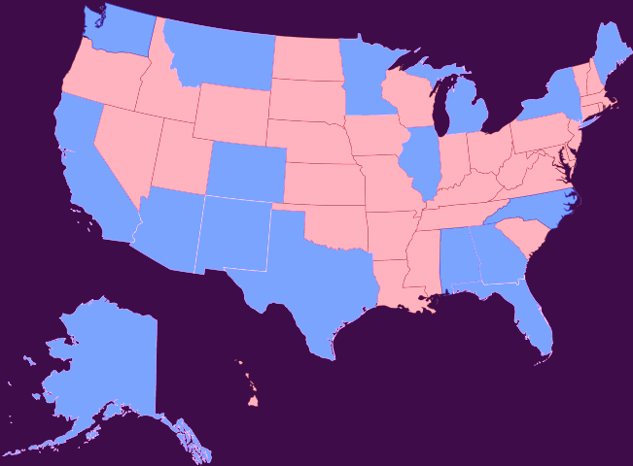
Methods
Target population: State or local epidemiologists, surveillance program managers
Target jurisdictions ( N=20)
Notes:
The first resolution passed in 1997, which recommended the formation of a disease surveillance network along the US-Mexico border to share information in this region with many sister cities and a high volume of border crossings.
As a result of this resolution, the Border Infectious Disease Surveillance (BIDS) project was initiated in 1999 by the Centers for Disease Control and Prevention (CDC), the Mexican Secretariat of Health and state and local health departments in US and Mexico border states.
As a binational effort, BIDS relies on local, state, and federal collaboration to improve infectious disease surveillance, build border-region epidemiology and laboratory capacity, and strengthen binational communication systems to improve disease prevention.

Slide 9
Methods
Southern border jurisdictions: California, Texas, New Mexico, Arizona
Northern border jurisdictions: Alaska§, Maine, Michigan, Minnesota§, Montana, Washington§
Top 10 ranked jurisdictions with Mexican-born population :* Colorado, Florida§, New York city§, Illinois, New York state, North Carolina, Georgia§, Oregon§
Pilot participants: San Diego County, Alabama
* Additional top Mexican-born states not included in Southern or Northern border states
§ Reporting the binational variable through ArboNet

Slide 10


Methods
Invitation to participate
E-mails
Phone calls
Data Collection
In-depth phone conversations
Notes:
Between 1996 to 2005, several infectious disease outbreaks occurred across the US – Mexico border, prompted concerns about insufficient binational coordination in epidemiology and surveillance. Therefore, CSTE has passed some resolutions related to cooperation between the US and Mexico.
Extra Info
______________________________________________________________
- Coccidioidomycosis in U.S. travelers to Baja California, 1996, and Sonora, 2000
- Dengue in Texas and Tamaulipas, 1999, and 2005
- Hepatitis A associated with frozen strawberries, 1997, and associated with green onions, 2003
- Histoplasmosis in Acapulco, 2001
- Salmonella poona associated with cantaloupes, 2000-2002
- Salmonella typhimurium associated with Mexican soft cheese, 2004-2005, in California
- Shigella sonnei associated with fresh parsley, 1998
Therefore, CSTE has passed some reslolutions related to cooperation between the US and Mexico.
Due to the high volume of individuals crossing the border every day for work, education, shopping, tourism, social visits, and other reasons, the border communities are closely interconnected. The border experiences public health challenges and issues that are distinctive to the region, due to the complexities of the relationship between the U.S. and Mexico. Often, there are challenges providing health care services, especially in disease prevention, surveillance, and control. Cross border collaboration is essential for these services to be accurate and effective.

Slide 11
Analysis
Preparation of data: Transcriptions
Data reduction: Motivations and barriers were categorized based on themes
Analysis: Participant responses were classified into three groups.
Southern border jurisdictions: U.S.-Mexico border jurisdictions**
Northern border jurisdictions: US-Canada jurisdictions
Top Mexican born states: Additional jurisdictions not included in Southern or Northern states ++
** Including San Diego County
++ Includes Alabama

Slide 12
Number of responses and response rate by region
Target Jurisdictions | Number of Target Jurisdictions | Number of Responding Jurisdictions | % of Responding Jurisdictions
Southern border** | 5 | 4 | 80%
Northern border | 6 | 3 | 50%
Top Mexican-born states* ++ | 9 | 4 | 44%
Total | 20 | 11 | 55%
* Additional top Mexican-born states not already included in Southern or Northern border state
+ 150,000 to 500,000 Mexican born in a metropolitan area
** Includes San Diego County
++ Includes Alabama
Notes:
In June 2011 CSTE recommended a binational pilot project for binational case and outbreak notifications using a communication pathway developed by the U.S. - Mexico Binational Technical Work Group Infectious Disease Section.
The pilot is a step to implementation of a previously CSTE endorsed guidelines document for cooperation on epidemiologic events of mutual importance.
The team developed a common list of binationally notifiable conditions and a protocol was implemented by Texas, New Mexico, Arizona, Sonora, CDC, and the Mexico Directorate of Epidemiology (DGE) in late November, 2011

Slide 13
Are you aware of the addition of the binational variable to NNDSS?
 | Southern border jurisdictions | Northern border jurisdictions | Top Mexican- born jurisdictions | Total
Yes | 4 | 1 | 2 | 7
No | 0 | 0 | 2 | 2
A little | 0 | 2 | 0 | 2
Total | 4 | 3 | 4 | 11
Quotes from jurisdictions:
“Since your e-mail , I printed your position statement and had a discussion with our enteric disease epidemiologist …………….., and we talked a little bit about why we might or might not want to be using this.”
Notes:
Additional non-border states from US and Mexico were solicited from initial pilot, which still on going.

Slide 14
Has your jurisdiction incorporated the binational variable into its notifiable disease surveillance system?
 | Southern border jurisdictions | Northern border jurisdictions | Top Mexican-born jurisdictions | Total
Yes | 4 | 0 | 0 | 4
No | 0 | 3 | 4 | 7
Total | 4 | 3 | 4 | 11
Quotes from jurisdictions:
“Some of this information is collected, but is not focused on Mexico or Canada, but is more generic. We have a generic question package for travel to capture if they are not residents of the U.S., but only for some diseases.”
Notes:
The idea is that when a pilot reportable case is discovered, it is promptly reported to different public health entities at different levels.
For example, if a case was found in an AZ border county, it would be reported to both the AZ state HD and the sister county HD in Mexico. At the AZ state level it would be reported to the Sonora HD, it’s sister state, and also to the CDC. Finally the CDC would report the case to its equivalent in Mexico, the DGE – The general directorate of epidemiology. Meanwhile, the same reporting flow would be occurring on the Mexican side. Certain events that are of bioterrorism concern or that are IHR (International Health Regulations) reportable could even be reported to the U.S. federal ASPR - Assistant Secretary for Preparedness and Response – and international PAHO – Pan American Health Organization – levels.

Slide 15
Are the binational case variable criteria clear to you?
 | Southern border jurisdictions | Northern border jurisdictions | Top Mexican- born jurisdictions | Total
Yes | 3 | 1 | 2 | 6
No | 0 | 1 | 1 | 2
Unsure | 0 | 1 | 1 | 2
Did not respond | 1 | 0 | 0 | 1
 | 4 | 3 | 4 | 11
Quotes from jurisdictions:
“I feel like these can be interpreted in multiple ways. Very ambiguous”
Notes:
U.S. binational reports are documented by the CDC Division of Global Migration and Quarantine and shared with DGE when appropriate.
Not all cases are reported to Mexico
Case has to meet the definition of UNEXPECTED or in other way something that needs to be reported immediately.

Slide 16
If not clear, what part of the criteria is not clear ?
 | Frequency*
Exposure to a suspected product from Mexico or Canada | 4
Case contacts in or from Mexico or Canada | 1
All Parts | 1
*Question allowed for multiple responses
Quotes from jurisdictions:
“Exposure to a suspect product from Mexico or Canada; that is ambiguous”
(Note: Includes those who responded no or unsure n=4)
Notes:
Notifications of binational cases to our unit are obtained in various different ways.
Bids officers located across the US –Mexico border report binational cases to USMU CDC. There are currently 4 BIDS surveillance officers along the entire US_Mexico border, 2 of which are located in CA.
NOTES:
________________________________________________________________
The need for border infectious disease surveillance was formally recognized in 1999 when the program was established and funded by the CDC. The program is currently managed by the CDPH OBBH and functions at a local level in California.
The BIDS program has many different objectives
In the past, the program has been able to provide laboratory equipment, supplies and reagents to both Imperial and San Diego County Public Health labs
Implement a variety of surveillance projects. I’ll discuss our current surveillance projects in a moment
Binational case reporting (which involves monitoring and follow up of binational cases and outbreaks and exchange of information with Mexico) has always been an objective of the program but has become more standardized over the last few years
BIDS Surveillance officers are also available to provide support to the local health departments (for example, with binational outbreak investigations, special projects ) at a capacity determined by the LHD
And finally, a goal of any BIDS project is to use data obtained through surveillance for prevention or outreach purposes

Slide 17
Are you planning on incorporating the binational variable into your notifiable surveillance system*?
 | Northern border jurisdictions | Top Mexican-born jurisdictions | Total
Yes | 1 | 0 | 1
No | 1 | 2 | 3
Unsure | 1 | 2 | 3
Total | 3 | 4 | 7
* Among jurisdictions who have not incorporated the variable.
Quotes from jurisdictions:
“Once this is available through the message mapping guides, we will have to figure out how to fit the data we currently collect
( country of usual residency) into the variable”
Notes:
This is a list of diseases that was agreed upon by US pilot participants and Mexico for the reporting pilot in 2011, and more will likely be added. However, most states report all binational disease, not just those that are on the list
IHR Reportable Diseases:
Always: smallpox, wildtype polio, influenza-new subtype, SARS
Can be: cholera, pneumonic plague, yellow fever, viral haemorrhagic fevers (ebola, lassa, marburg), west nile fever, etc.

Slide 18
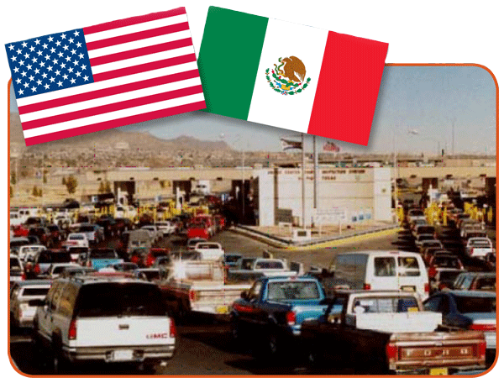
Reasons why jurisdictions have incorporated the binational variable?
Motivations (N=4)
Category | Total
Part of BIDS | 2
Border jurisdictions | 1
Follow up of cases | 2
Note: Only includes those that already incorporated the variable into their surveillance system.
Might include more than one reason per jurisdiction.

Slide 19

Reasons why jurisdictions have not incorporated the binational variable?
Barriers (N=7)
Believe information already being collected | 2
Don’t see the benefit | 2
Not in mapping guidelines | 2
Ambiguity of the criteria | 1
Resource priority | 2
Note: Only includes those that have not already incorporated the variable into their surveillance system. Might include more than one reason per jurisdiction.

Slide 20
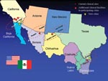
Additional comments from discussion
Comments (N=11*)
Need to see benefit | 3
Feedback from program the data is reported to | 2
Waiting for message mapping guidelines | 2
* Six (6) jurisdictions provided additional comments. Includes more than one comment per jurisdiction.

Slide 21
States Reporting the Binational Variable in ArboNet (N=13)*, Snapshot May 24, 2016
 | Dengue | Chikungunya | Zika
Potentially exposed while in Mexico or Canada | 9 | 10 | 2
Other situations that may require binational notification or coordination of response |  | 1 | 11
Potentially exposed by a resident of Mexico or Canada | 1
* 12 States report Arboviruses through NNDSS

Slide 22
Summary
4 of 11 jurisdictions implemented the binational variable into NNDSS.
1 jurisdiction is planning to incorporate the variable soon.
13 jurisdictions have reported the binational variable through ArboNET since April 2016.
Many jurisdictions may have a different understanding of the variable than what was intended.
A reason for implementation was to increase binational communication and collaboration between the U.S. and Mexico on binational public health issues and events.
Barriers included lack of clarity, don’t see the benefit, and a resources priority.
There is a need for feedback and information from jurisdictions

Slide 23
Conclusions
Clarification is needed on the criteria for a binational case.
Proof or ROI of the added value of the binational variable is needed.
Generic v2 of the message mapping guide may facilitate implementation.

Slide 24
Acknowledgements
Participating states/jurisdictions in survey
Katrin Kohl (Present, acting Unit Lead, U.S.-Mexico Unit)
Alba Phippard, USMU Unit for her constructive criticism and friendly advice during the project work
Steve Waterman (Former, Unit Lead, U.S.-Mexico Unit)
Andy Thornton and Aidan Varan (former CDC/CSTE Applied Epidemiology Fellows, CDC U.S.-Mexico Unit)

Slide 25
Thank you!
Gabriela Escutia, MPH
CDC/CSTE Applied Epidemiology Fellow
Centers for Disease Control and Prevention
Division of Global Migration and Quarantine
County of San Diego Health and Human Services Agency
Epidemiology and Immunization Services Branch
kvd2@cdc.gov
For more information please contact Centers for Disease Control and Prevention
1600 Clifton Road NE, Atlanta, GA 30333
Telephone: 1-800-CDC-INFO (232-4636)/TTY: 1-888-232-6348
Visit: www.cdc.gov | Contact CDC at: 1-800-CDC-INFO or www.cdc.gov/info
The findings and conclusions in this report are those of the authors and do not necessarily represent the official position of the Centers for Disease Control and Prevention.
National Center for Emerging and Zoonotic Infectious Diseases
Division of Global Migration and Quarantine

