Slide 1
Discussion Questions
Review the binational variable position statement: Does the position statement need to be modified?
Would DGMQ provide this information to the other countries?
Does the binational variable have more meaning, with ebola, dengue, chikungunya, and now zika?
Originally, the binational variable included other countries. Should they be added?
What do states need to justify BV implementation?

Slide 2
Operational Protocol for U.S. – Mexico Binational Communication and Coordination on Disease Notifications and Outbreaks --- DRAFT
Table of Contents
1. Introduction
2. Purpose
3. Events Leading to a Binational Communication
4. Communication between Counterparts
5. Information Included in Binational Communications
6. How to Conduct Binational Communications
How to Conduct Binational Outbreaks and Investigations
Appendix 1: IHR (2005)
Appendix 2: United States and Mexico Case Definitions of Binationally Notifiable Conditions
Appendix 3: Binational Contact Numbers
Appendix 4: Template Terms of Reference for a Binational Outbreak Investigation
Appendix 5: Procedures for Sharing Laboratory Resources and Specimens during Public Health Events of Mutual Interest and Binational Outbreaks
Appendix 6: List of Agencies and Organizations
Submitted for clearance by states, US and Mexico

Slide 3
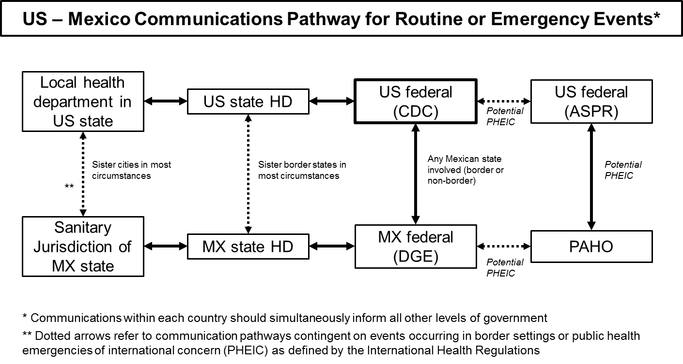
* Communications within each country simultaneously inform all other levels of government
** Dotted arrows refer to communication pathways contingent on events occurring in border settings or public health emergencies of international concern (PHEIC) as defined by the International Health Regulations
ASPR = Assistant Secretary for Preparedness and Response PAHO = Pan American Health Organization
DGE = Mexican Directorate General of Epidemiology PHEIC = Public Health Event of International Concern
HD = Health Department MX = Mexico

Slide 4
List of Binationally Notifiable Conditions
All binational outbreaks Unusual conditions of special public health concern IHR reportable (within 24 hours): Always Smallpox Polio Human influenza, new subtype SARS Ebola Potentially Cholera Plague Yellow Fever Agents of bioterrorism concern | Others: Brucellosis Campylobacteriosis Legionellosis Listeriosis Meningococcal Disease Rabies, human Rickettsial disease Salmonellosis Shigellosis Syphilis Tuberculosis Vaccine preventable diseases viral hepatitis measles pertussis rubella tetanus varicella

Slide 5
List of Binational Notifiable Conditions³
West Nile Virus
initial case each season in border state, binational or otherwise
if exposure suspected in Mexico and diagnosed in the US
Severe dengue
initial case each season in border state, binational or otherwise
if exposure suspected in US, and diagnosed in Mexico
Chikungunya
initial case each season in border state, binational or otherwise
if exposure suspected in US, and diagnosed in Mexico
3 Confirmed and probable cases meeting binational case definition. Suspect cases also reported if situational awareness warrants such a report, e.g., high probability suspect measles. This list includes consensus conditions for which binational notification is strongly suggested; however, other conditions may be reported as necessary.
Note: Tuberculosis notification between the United States and Mexico is frequently managed by binational referral programs, such as CureTB, in coordination with local, state, and federal authorities.

