Slide 1

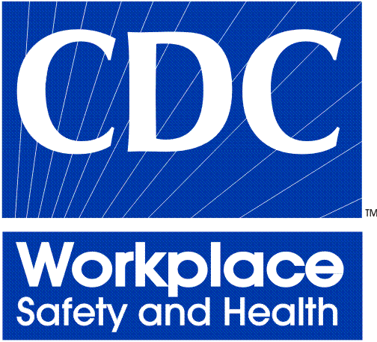


State-Specific Prevalence of Asthma Among Adults, by Industry and Occupation —
Behavioral Risk Factor Surveillance System, 21 States, 2013
Katelynn E. Dodd^{1,2}, MPH and Jacek M. Mazurek¹, MD
¹Respiratory Health Division, National Institute for Occupational Safety and Health (NIOSH), Centers for Disease Control and Prevention (CDC), Morgantown, WV, USA
²Association of Schools and Programs of Public Health (ASPPH)/CDC Public Health Fellow
Background
Results
Results
In 2010, 7.7% of U.S. adults had current asthma
Approximately 15% of current asthma may be related to work (range: 4–58%)
Asthma prevalence is higher in certain industries and occupations
Identifying workers with asthma by industry and occupation may inform intervention and prevention efforts
Figure 2. Top three industries¹ with highest current asthma prevalence by state among adults employed in last 12 months
Figure 3. Top three occupations¹ with highest current asthma prevalence by state among adults employed in last 12 months
Figure 4. Prevalence of current asthma by state and employment status
7.7% ²
7.7% ²
Objective
To assess state-specific proportion of adults with current asthma by employment status and by industry and occupation
Methods
Data Source
Behavioral Risk Factor Surveillance System (BRFSS) adult data from 21 states collected through landline and cellular telephone interview during 2013
Study Population
Adults ≥18 years (n=208,788)
Definitions
Current asthma defined as “yes” response to both of the following questions
“Have you ever been told by a doctor or other health professional that you have asthma?”
“Do you still have asthma?”
Employed at some point in the 12 months prior to interview
Employed for wages, out of work for <1 year, or self-employed
Unemployed for 12 months or more
Out of work ≥1 year, homemaker, student, retired, unable to work
Industry
“What kind of business or industry do/did you work in?”
Classified by NIOSH coders in 21 groups based on 2002 North American Industry Classification System (NAICS)
Occupation
“What kind of work do/did you do?”
Classified by NIOSH coders in 23 groups based on 2000 Standard Occupational Classification System (SOC)
Analysis
SAS® version 9.3 (SAS Institute Inc., Cary, NC)
Estimates weighted to be representative of state populations
Figure 1. States with information on industry and occupation for adults
WA
ID
OR
MT
ND
MN
ME
WI
VT
SD
MI
NY
WY
NH
CA
MA
RI
NV
UT
NE
IA
IL
IN
OH
PA
NJ
CT
CO
WV
MD
DE
KS
MO
KY
VA
AZ
NM
OK
TN
NC
TX
AK
SC
MS
AL
GA
AK
LA
Included
Not included
Limitations
FL
Asthma self-reported and not validated by medical chart review; may be subject to recall bias and misclassification
Small sample sizes resulted in unreliable estimates for some industries and occupations and no information was available to assess asthma in relation to workplace exposures (e.g., work-related asthma diagnosis, age at onset, history of asthma, asthma severity)
Workers with current asthma may leave employment in industries and occupations with workplace exposures (i.e., healthy worker effect)
Differential access to health care (e.g., health insurance, cost of treatment) could bias results
Results may not be representative nationally or of non-participating states
HI
Summary/Recommendations
Results indicate state-to-state variations in asthma prevalence by industry and occupation
Prevalence of current asthma greater among adults unemployed for a year or more than those employed sometime in the last 12 months
Routine collection of industry and occupation data with BRFSS would allow for assessment of trends and more detailed analysis of industry and occupation
Future studies should assess the impact of access to health care (e.g., health benefits offered by employer) by industry and occupation on the proportion of adults with current asthma
¹ Additional information on 2002 NAICS available at http://www.census.gov/cgi-bin/sssd/naics/naicsrch?chart=2002.
² Overall current asthma prevalence among adults employed in last year in 21 states.
³ Unreliable estimates with a relative standard error ≥30% were not reported.
¹ Additional information on 2000 SOC available at http://www.bls.gov/soc/home.htm.
² Overall current asthma prevalence among adults employed in last year in 21 states.
³ Unreliable estimates with a relative standard error ≥30% were not reported; sample size was inadequate to assess current asthma prevalence by occupation in Louisiana.
For more information, please contact Katelynn Dodd, MPH.
1095 Willowdale Rd, Morgantown, WV 26505
Telephone: 304-285-6305 E-mail: kedodd@cdc.gov Web: www.cdc.gov/niosh
This presentation was supported by Cooperative Agreement Number 3U36OE000002 from the Centers for Disease Control and Prevention and the Association of Schools and Programs of Public Health (ASPPH). The findings and conclusions of this report are those of the authors and do not necessarily represent the official views of NIOSH, CDC, or ASPPH. The authors have no relevant financial relationships to disclose.

