Slide 1


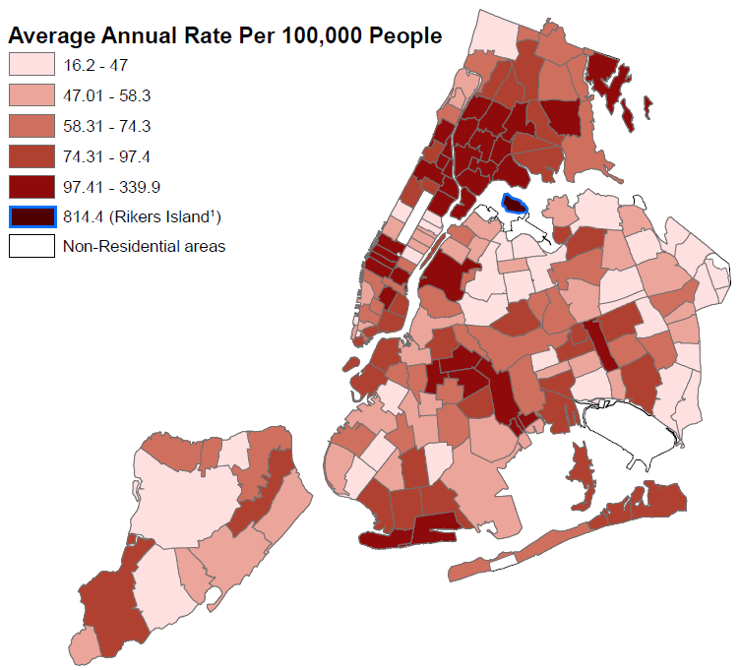
An Epidemiologic Profile of Chronic Hepatitis C Virus Infection in New York City
Andrea King MPH, Perminder Khosa MPH, Olivia C. Tran MPH, Miranda S. Moore MPH,
Jennifer Baumgartner MSPH, Fabienne Laraque MD MPH
New York City Department of Health and Mental Hygiene, Queens, NY
RESULTS
OBJECTIVE
RESULTS
CONCLUSIONS
To create a citywide epidemiologic profile of chronic Hepatitis C virus (HCV) infection to better understand the burden of HCV in New York City and inform current and future public health interventions for prevention, surveillance, and treatment of HCV infection.
Table 1: People Newly Reported with Chronic Hepatitis C in New York City, 2014
 | Number | Percent of Each Group | Rate Per 100,000 People
Overall | 7,691 | N/A | 91.5
Sex
Female | 3,049 | 39.6 | 69.4
Male | 4,641 | 60.3 | 115.7
Transgender | 1 | 0.0 | N/A
Unknown | 0 | 0.0 | N/A
Age at Time of First Report (in years)
0-19 | 92 | 1.2 | 4.6
20-29 | 747 | 9.7 | 53.3
30-39 | 1,102 | 14.3 | 84.1
40-49 | 1,218 | 15.8 | 107.8
50-59 | 2,075 | 27.0 | 194.4
60-69 | 1,754 | 22.8 | 224.2
70-79 | 486 | 6.3 | 110.9
80+ | 217 | 2.8 | 74.0
Neighborhood Poverty Level by Zip¹
Low (<10% below poverty) | 984 | 13.7 | 59.2
Medium (10 to <20%) | 2,303 | 32.1 | 76.7
High (20 to <30%) | 1,781 | 24.9 | 83.5
Very High (>=30%) | 1,659 | 23.1 | 103.1
Unknown | 440 | 6.1 | N/A
¹ Neighborhood poverty based on zip code was defined as the percentage of residents with incomes below 100 percent of the Federal Poverty Level, per American Community Survey data from 2008 to 2012. Excludes 524 persons incarcerated at time of report.
People Newly Reported with Chronic Hepatitis C
in New York City by Zip Code, 2013-2014
In 2014, 7,691 persons were newly reported with HCV infection (Table 1). Rates were higher among men (115.7) than women (69.4) and among those 50-59 (194.4) and 60-69 years old (224.2) than among 40-49 year-olds (107.8) and 30-39 year-olds (84.1). Rates were higher in zip codes with high (83.5) or very high (103.1) percentages of residents living below the federal poverty threshold compared with rates in low poverty areas (59.2).
The highest rate of chronic hepatitis C was seen in the New York City incarcerated population at 814.4 per 100,000 people. All persons from a New York City correctional facility were aggregated to Rikers Island.
Neighborhoods with the highest chronic hepatitis C rates were East Harlem, Manhattan and Morrisania/Hunts Point, Bronx.
The burden of HCV infection is unequally distributed in NYC, with higher rates among men and residents of high poverty areas, and wide neighborhood variations. A high proportion of HCV-HCC cases occur among minorities, and HIV infection is higher among those with HCV than in the general population.
These findings underscore the need for each locality to develop an epidemiologic profile, using diverse data sources, of both HBV and HCV infection, and to use the resulting information for program planning.
BACKGROUND
E. Harlem
Morrisania / Hunts Point
HCV is the most common blood-borne infection in the United States, affecting over 3 million people¹, of whom an estimated 146,000 live in New York City (NYC)². Describing the distribution of HCV is essential to estimating the burden of disease among those infected with HCV in NYC.
The availability of highly effective medications underscores the importance of a public health approach to this disease. The NYC Department of Health and Mental Hygiene (DOHMH) leveraged resources, including electronic disease surveillance and cancer registry data, to create a NYC epidemiologic profile for HCV infection.
References
Denniston MM, Jiles RB, Drobenuic J, et. al. Chronic Hepatitis C Virus Infection in the United States, National Health and Nutrition Examination Survey 2003 to 2010. Ann Intern Med. 2014;160(5):293-300.
2. Balter S, Stark JH, Kennedy J, et. al. Estimating the prevalence of hepatitis C infection in New York
City using surveillance data. Epidemiol Infect. 2014(142):262–9.
RECOMMENDATIONS
All states and large local health departments should be afforded the ability and resources to produce a profile of their HBV and HCV cases.
Surveillance for viral hepatitis should be universal, supported by the federal government, and ideally based on electronic laboratory reporting.
Using a variety of databases, including death and cancer registry and specific surveys, will improve epidemiologic profiles created with surveillance data.
The resulting profile will be useful for program planning and to measure progress:
  Where to place programs and who to target
  Use laboratory results to measure testing patterns, linkage to are and treatment uptake
  Monitor program impact
¹All persons reported from a New York City correctional facility have been aggregated to Rikers Island.
From 2001–2012, 3,392 persons with HCV infection were diagnosed with HCC. They account for 38.4% of HCC diagnoses in this period. Of the 3,392 persons, most (74.5%) were men. The majority of cases were Hispanic (35.0%) or non-Hispanic Black (30.1%), followed by non-Hispanic White (29.1%), and Asian/Pacific Islander (5.3%). More than half (55.9%) of HCV-HCC cases resided in high or very high poverty areas.
There were 160,854 persons with HCV infection in the cross-registry matched dataset.
Of these, 14.4% were infected with HIV, compared with approximately 1.4% of New Yorkers overall, and 3.2% were co-infected with hepatitis B virus.
METHODS
We conducted descriptive analyses of HCV cases newly reported in 2014 by various demographic and geographic characteristics. Zip code-based poverty level, the percentage of residents with incomes below 100 percent of the Federal Poverty Level per the American Community Survey 2008–2012, was used to examine associations with poverty. The association with hepatocellular carcinoma (HCC) was examined by matching New York State Cancer Registry data from 2001–2012 to viral hepatitis surveillance data from 1999–2012. To assess co-infections, 2000–2013 data were matched across DOHMH surveillance registries, including HIV, tuberculosis, hepatitis C, and hepatitis B. Rates per 100,000 people were calculated.
Table 2: New York City Residents with HCV infection and Hepatocellular Carcinoma, Diagnosed Between 2001-2012
 | Hepatitis C |  | Total with HCC
 | Number | Percent of Each Group | Number | Percent of Each Group
Number of Individuals | 3,392 | NA | 8,827 | N/A
Sex
Male | 2,526 | 74.5 | 6,607 | 74.8
Female | 866 | 25.5 | 2,220 | 25.2
Race/Ethnicity
White, Non-Hispanic | 987 | 29.1 | 2,532 | 28.6
Black, Non-Hispanic | 1,022 | 30.1 | 2,040 | 23.1
Asian/Pacific Islander | 178 | 5.3 | 1,656 | 18.8
Hispanic | 1,187 | 35.0 | 2,553 | 28.9
Other/Unknown | 18 | 0.5 | 46 | 0.5
Neighborhood Poverty Level¹
Low (<10 percent below poverty) | 461 | 13.6 | 1,445 | 16.4
Medium (10 to <20 percent) | 1,039 | 30.6 | 2,864 | 32.5
High (20 to <30 percent) | 964 | 28.4 | 2,492 | 28.2
Very high (≥30 percent) | 933 | 27.5 | 2,023 | 22.9
¹ Neighborhood poverty level (based on zip code at the time of hepatocellular carcinoma diagnosis) defined as percent of residents with incomes below 100 percent of the Federal Poverty Level, per American Community Survey. Survey year used depends on year of hepatocellular carcinoma diagnosis (U.S. Census used for 2000-2004).
Table 3: Proportion of persons with Hepatitis C that matched to each of the other disease registries, New York City, 2000-2013
Total Matched Persons with Hepatitis C | 160,854
Disease | Proportion
HIV | 14.4
Tuberculosis | 0.4
Hepatitis B | 3.2
Syphilis (Primary, Secondary, and Early Latent) | 1.0
Gonorrhea | 1.4
Chlamydia | 2.2
Source: NYC Department of Health and Mental Hygiene, Division of Disease Control, PCSI Syndemic Project, 2015
ACKNOWLEDGEMENTS
Thanks to everyone who provided expertise and hard work to make this project possible, particularly Katherine Bornschlegel, Emily McGibbon, Baozhen Qiao, Maria Schymura, PCSI Data Advisory Committee, Sonny Ly, and Julie Yuan.
CONTACT INFORMATION
Andrea King
aking@health.nyc.gov
347-396-7611

