Slide 1
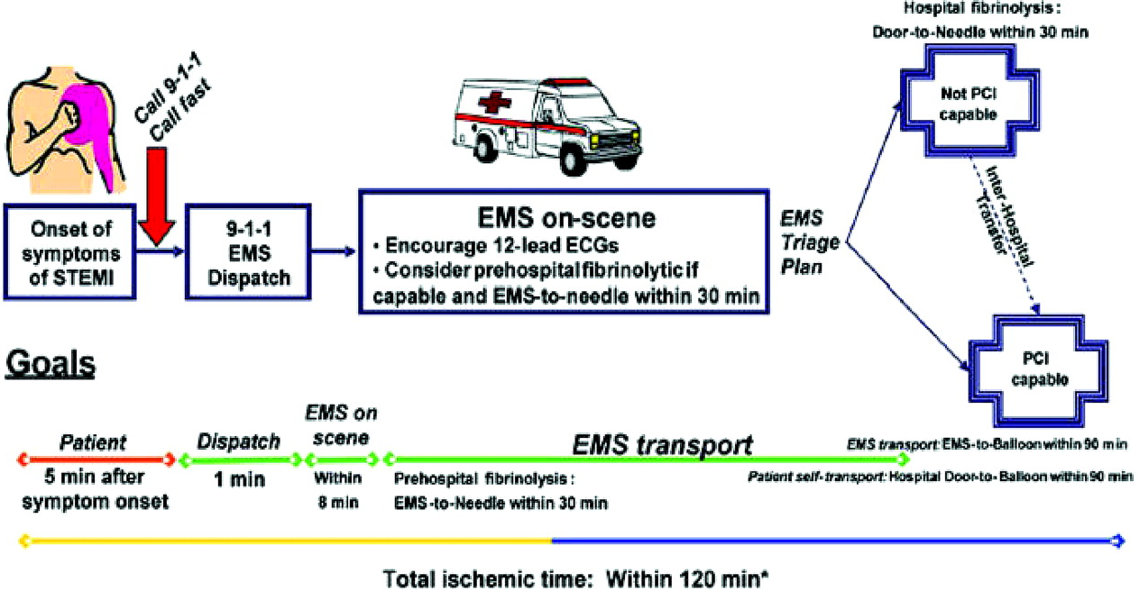
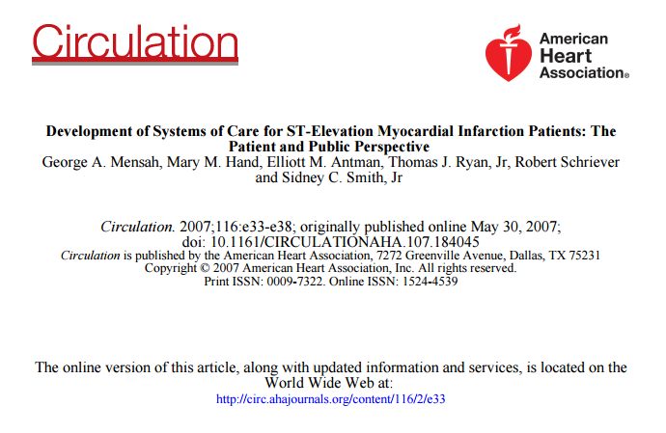
Time to Time to treatment is critical in STEMI

Slide 2
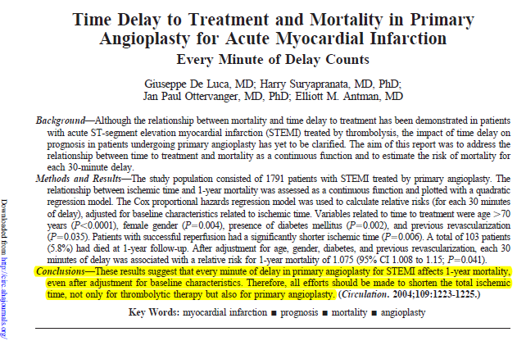

Slide 3
Median Ischemic Times in Texas, 2011-2015

