Slide 1


Using Epi Rapid Response Teams During a Regional Response to Influenza Case Increase
Kristy M. Bolen, MPA BS
Senior Regional Epidemiologist
June 6, 2017

Slide 2

Objectives
Discuss Kentucky’s Epi Rapid Response Teams
Discuss Investigation Methods Used
Discuss Epidemiologic Data

Slide 3
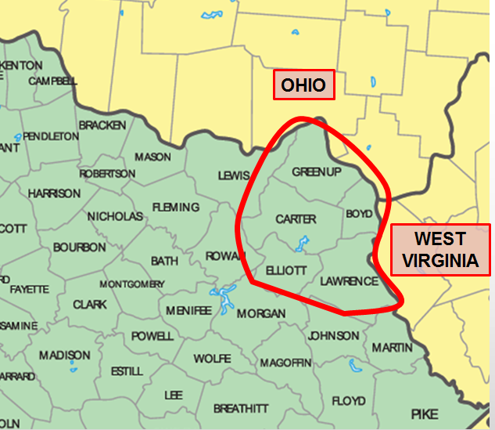
Boyd 48, 324
Carter 27,158
Elliott 7,648
Greenup 36,068
Lawrence 15,745
Total 134,944
Hospitals:
King’s Daughters Medical Center
Our Lady of Bellefonte Hospital Three Rivers Medical Center

Slide 4
Epi Rapid Response Teams
Started in late 1980’s to enhance epi capacity at local health departments in Kentucky
Program has continued after creation of regional epidemiologist positions in 2003
Currently there are over 400 members in Kentucky
  17 in Fivco Region
    2 Directors
    8 Nurses
    7 Registered Sanitarians

Slide 5
Epi Rapid Response Team Training
Two day face-to-face training
  Outbreak investigation steps
  Disease specific investigations
  Lab sample collection
Practical Tabletop Exercise
  Scenarios include Ebola, Pandemic Flu, Enteric Illnesses
  Must attend after initial training and once every 3 years
Four hours of CEU training every year
Attend ERRT Conference twice every four years

Slide 6
Epi Rapid Response Teams in Fivco
Each health department in the region has an ERRT group
Each group has responded to local outbreaks in their county
  Usually foodborne and mostly localized
ERRT Groups do not typically cross jurisdictions to help with investigations
  Even if they are involved in the same outbreak investigation
    Example: Cantaloupe/Salmonella investigation 2012

Slide 7
Background
Typically providers in the Fivco area used rapid flu testing to diagnose/treat flu
  Some clinics provided crude ILI and rapid test result data to regional epidemiologist
  This plus KDPH’s weekly Flu View gave an overview of flu activity in the region
In 2014, Hospital System A acquired a PCR respiratory multi-pathogen panel machine for in-patient testing
  Mostly used in Pediatric cases to distinguish quickly between RSV, Flu and Enterovirus

Slide 8
Background
In October 2015, Hospital A purchased single-pathogen molecular flu testing machines for each of their Family Care Centers, Urgent Care Centers and Emergency Departments in the Tri-State Area
  Urgent Care centers received up to 6, Family Care Centers up to 3 and the Emergency Departments up to 6 machines per site
Epidemiologist was notified in late January about the switch in testing methods
On February 18th KDPH issued an outbreak number for a Regional Influenza Outbreak

Slide 9
Use of Epi Rapid Response Teams
Team members used for a variety of tasks during response
  Interviewing Cases
    Vaccination Status, Tamiflu Usage, S/S, School/Work/Daycare
  Gathering other data such as school attendance, Tamiflu supplies
  Answering phone calls from the public
    Using a pre-crafted Talking Points Sheet developed by shared PIO
  Imputing line list data
Each LHD ERRT group worked differently but all contributed to the regional response

Slide 10
Results
1,522 cases were investigated from January 1-May 31, 2016
  54% of the cases were ages 0-18 years
  53.0% were Female
57.6% of the cases were interviewed by a LHD nurse, ERRT member or Nursing Student
Of the interviewed cases (N=876), 75.5% of cases were unvaccinated
  81.7% of Pediatric cases
    Of vaccinated cases, high percentage had received live vaccine (FluMist)
  68.2% of Adult cases
    Of vaccinated cases, most were ages 60 years and older

Slide 11
Results
33 hospitalizations
  1 death reported in April (Type B influenza)
Of Interviewed Cases (N = 876)
82.1% reported Cough
61.7% reported Congestion
96% reported Fever
  Average: 101.3⁰ F; Range: 99-105⁰ F
Most common other symptoms reported were: N/V/D, Body Aches, Headache, Fatigue & Chills

Slide 12
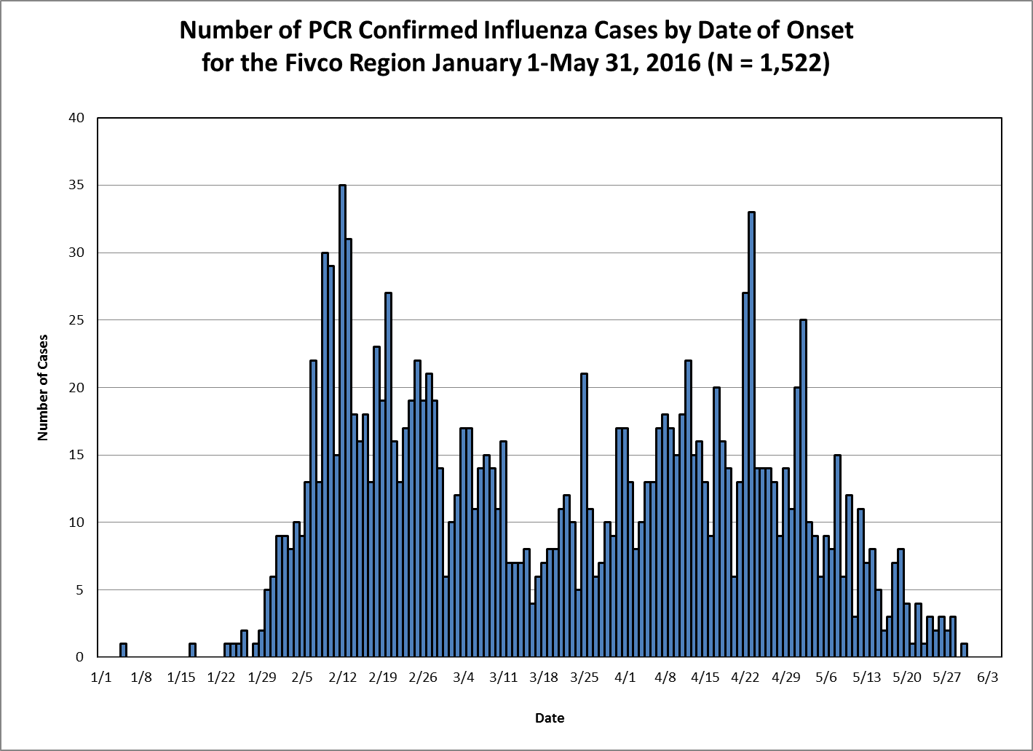

Slide 13
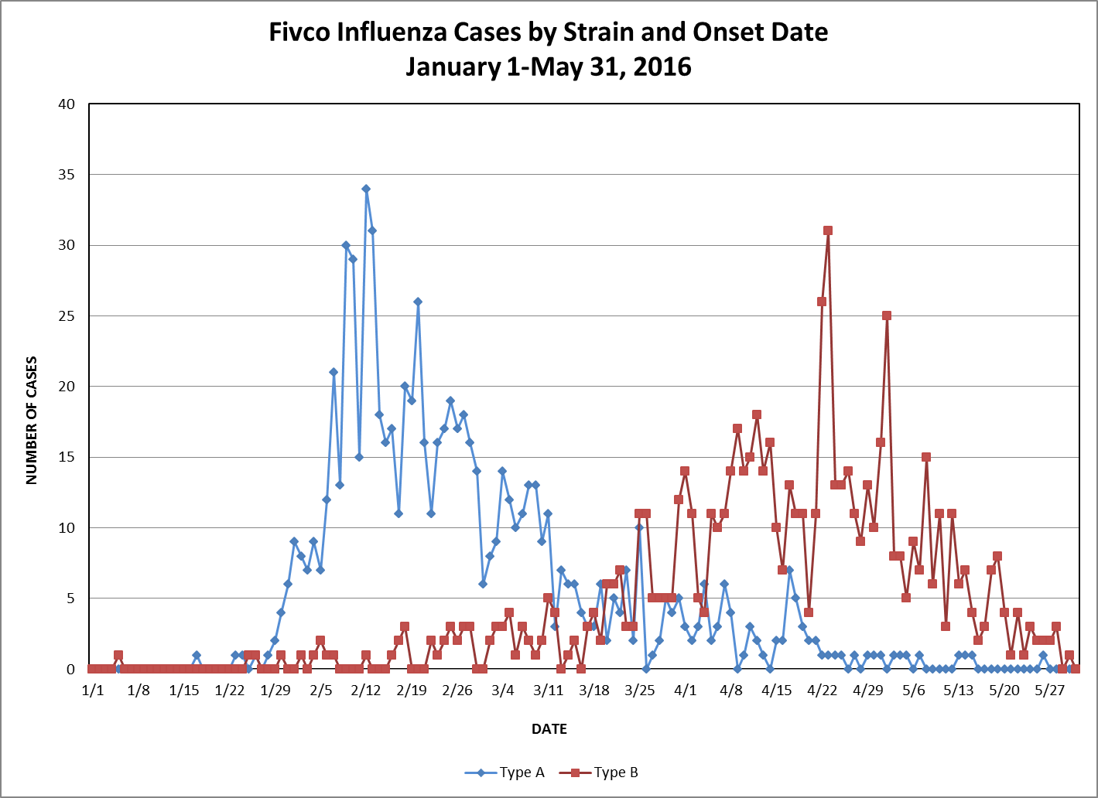

Slide 14
Total Regional LHD Cost for Response
Approximately 1,500 hours spent on the response
  From employee time log sheet created for response
  For all employees who worked on some part of the investigation
$45,000 spent from February 18-May 31
  Includes salary and fringe
This doesn’t include Regional Epidemiologist or Regional Preparedness Coordinator’s time

Slide 15
Conclusion
Using Epi Rapid Response Teams can help local health departments save resources during large, regional outbreak investigations
Communities need more information on flu vaccination
  Especially for children and middle aged adults
  Vaccine can be given anytime during the flu season
As PCR technologies become less expensive and easier to use, increases in cases will occur and will potentially overwhelm small local health departments.

Slide 16
Questions?
Kristy M. Bolen, MPA BS
Senior Regional Epidemiologist
Serving the Fivco Area
2924 Holt Street
Ashland, Kentucky 41101
Email: KristyM.Bolen@ky.gov
Phone: 606-329-9444 ext 2232

