Slide 1


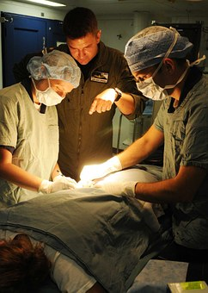
Extent of Training of the Infection Prevention Contact in Acute Care Facilities, Nursing Homes and Ambulatory Surgery Centers in Nebraska
￼
Maureen Tierney, MD, MSc. Director, HAI Program, Nebraska DHHS, Xiao Wang, MPH, HAI Health Surveillance Specialist, Tom Safranek, MD, State Epidemiologist, DHHS
BACKGROUND
The Healthcare-Associated Infections (HAI) team at the Nebraska Department of Health and Human Service (DHHS) believes that in order to accomplish improved infection prevention practices in acute and long term care facilities, it is important to understand the level of IP knowledge and training of the person considered the contact or lead in infection control at each institution.
As part of our ICAR activities the person designated to be the infection prevention (IP) contact for all ACH, nursing homes and ambulatory surgicenters was ascertained.
METHODS
A survey was faxed to:
Prospective payment system hospitals (PPS)
Critical Access Hospitals (CAHs)
Nursing Homes
Ambulatory Surgery Centers (ASCs)
Follow up faxes to non responders
What % of a (FTE) was devoted to IP?
Have they had any training in IP including an APIC course, Nebraska Infection Control Network (NICN) course, or Certification in Infection Control and Epidemiology (CIC) courses?
Were they CIC certified?
RESULTS (%FTE)
ASCs
Nursing Homes
RESULTS IC TRAINING
PPS
PPS
80% had a 100% FTE devoted to IP
90% had at least 75% FTE devoted to IP
CAHs
1/3 had one 100% FTE for IP
1/3 had less than 25% FTE focused on IP
ASCs
72% had less than 25% of a FTE
Nursing Homes
1/3 had one 100% FTE
50% less than 25% FTE
https://pixabay.com/en/surgery-surgeons-operation-medical-857140/
CONCLUSIONS
Most PPS hospitals had at least one full FTE devoted to IC, but less than 50% had a lead IP with CIC
Only 1/3 of nursing home IC contacts had specialized training in IC and 50% had less than .25 FTE devoted to IP
Both CAHs and ASCs had higher levels of IP training than previously anticipated by the team but less time devoted to IP than desirable
A focus on IC training and IP staffing in non-acute care facilities may prove to be beneficial in decreasing rates of HAIs in the state
Objective
To determine the amount of time the designated IP contact in an institution spent on IP and what type of IP training they had. Efforts to improve the level of IP education can be made once this information is known. Recommendations and education provided to the infection control representative can then be spread by them to the rest of his/her facility.
CAHs

