Slide 1


Investigation of an Outbreak of Cryptosporidiosis Associated with a High School Football Team in Michigan
Julie Kettlehut Payne, MPH

Slide 2
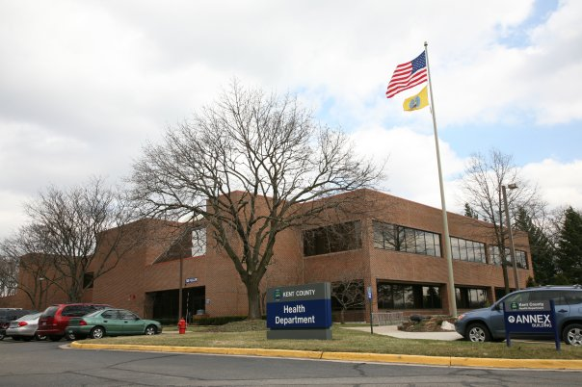
Background
In August 2016 – The Kent County Health Department (KCHD) in MI, investigated an outbreak of gastrointestinal illnesses associated with a varsity football team at a local high school.

Slide 3
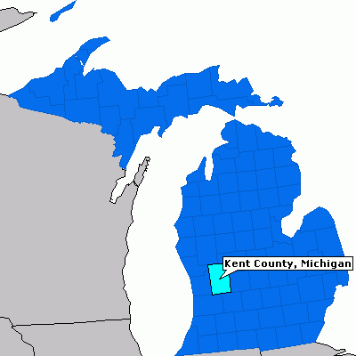
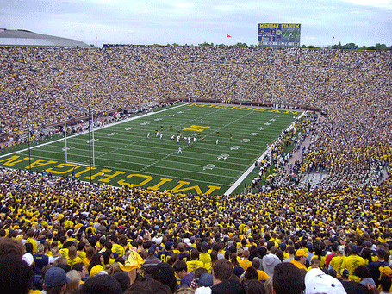
“The Great Lakes State”
Kent County, MI
Ann Arbor, MI

Slide 4
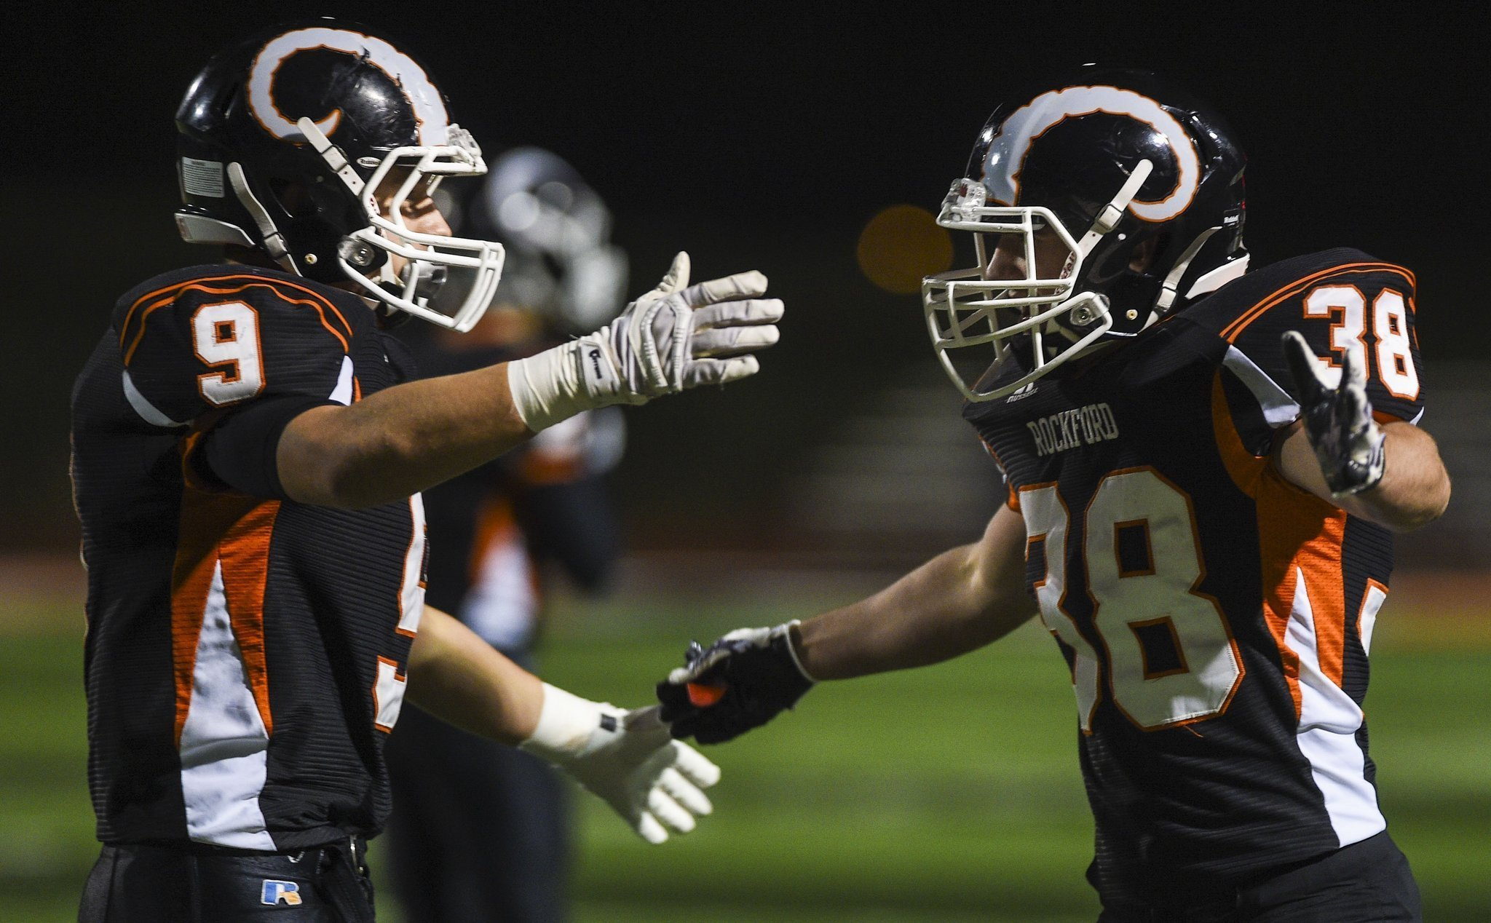
Background
August 24, 2016
1:00 PM – HD got a call from a Dr. Office about a possible case of cryptosporidiosis. Doctor heard his patient’s fellow football team member was sick with suspected cryptosporidiosis. His patient had a similar presentation.
3:30 PM- Local High School Nurse reported approximately 30/60 players ill.

Slide 5
Timeline
August 25, 2016-Morning
KCHD received laboratory confirmation of it’s first case of cryptosporidiosis
Outbreak team assembled for a meeting- Environmental Health Division Chief, Sanitarians, Communicable Disease Nurses, Epidemiologists, Emergency Preparedness Coordinator, Communications Manager, Health Officer, and Medical Director

Slide 6
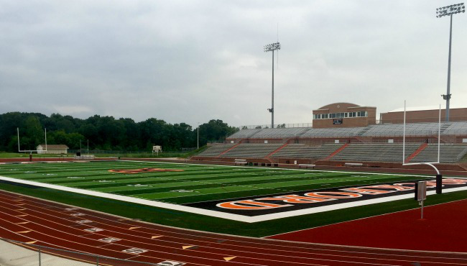
Players seen vomiting on the high school football field Monday 8/22/16 and Tuesday 8/23/16 during a pre-season practice.

Slide 7
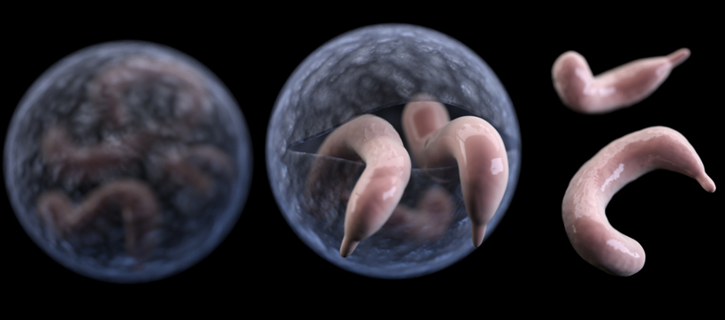
Cryptosporidiosis Review
Disease caused by a parasite that lives in animals and humans and results in watery diarrhea (vomiting, fever, weight loss, dehydration, gas/bloating)
Transmitted via fecal-oral route, water, uncooked food, soil, and sexual contact
The parasite has a hard shell and can live outside the body for long periods of time and it is resistant to bleach based disinfectants
1-12 day (average of 7 days) incubation period, and lasts for 1-2 weeks, can be treated with Nitazoxazanide

Slide 8
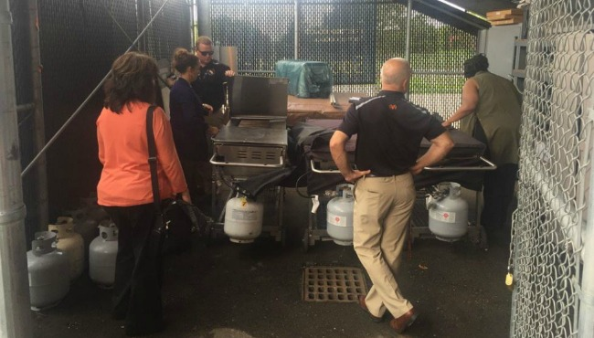
Methods- KCHD Environmental Inspection
August 25, 2016
Met with the AD. Inspected indoor portable electronic water storage tanks, pool and pump room, locker rooms, kitchen, outdoor grills and concession stand, irrigation well head and connections on the field.

Slide 9
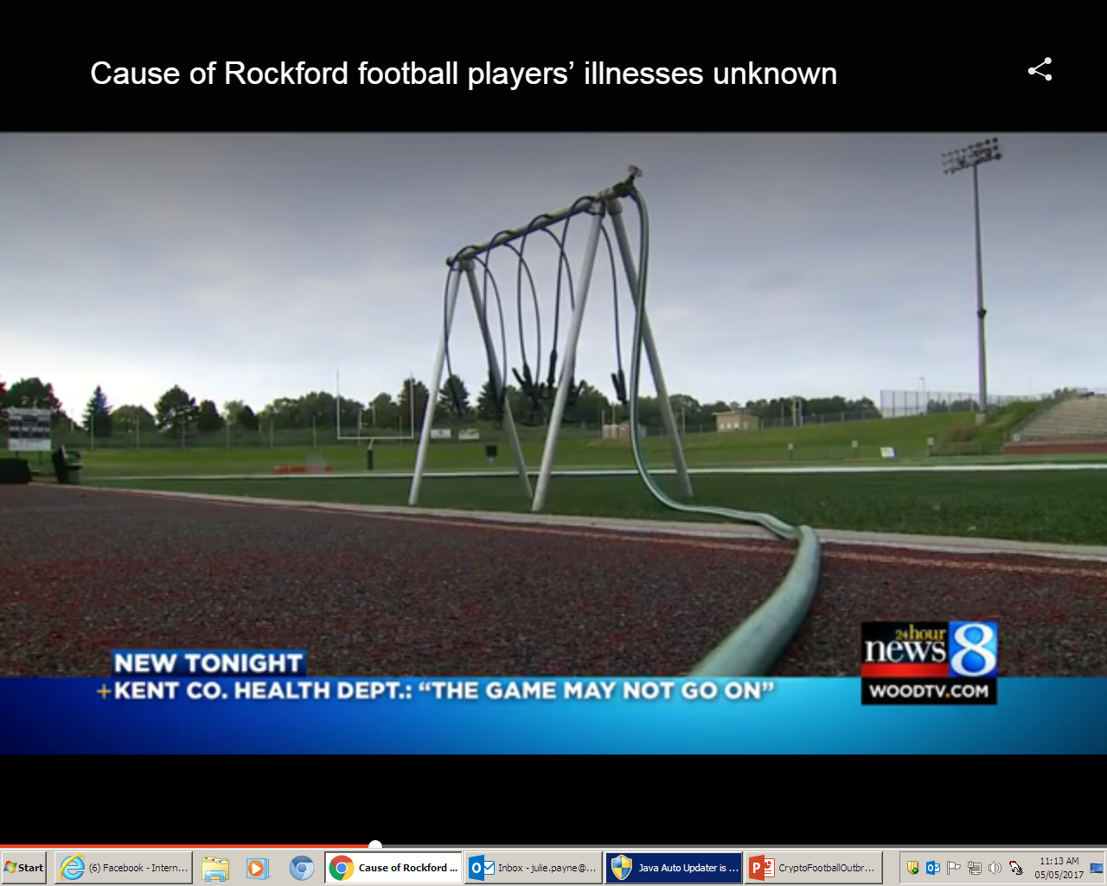
Sports Water Hydration system
System was connected to an outside spigot without backflow protection and under continuous pressure.
Was not routinely sanitized and was exposed to the elements.
A sample test was taken and later came back negative for coliform bacteria.

Slide 10
Methods-Environmental Investigation
The school water supply was soon ruled out as source of illnesses as it was noted other sports teams that had been practicing were not ill.
Focus soon changed to other foodborne exposures:
“Brown Bag Luncheon” at a scrimmage on August 17, 2016.
Community event with the football team where food was served on Friday August 19, 2016

Slide 11
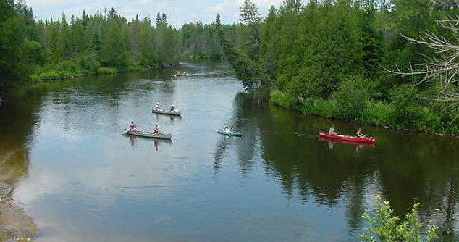
Methods - Environmental Investigation
Interviews with mothers of football team members helped to identify a pre-season riverside camping retreat that players, coaches, and fathers attended prior to onset of illnesses.
Au Sable River

Slide 12
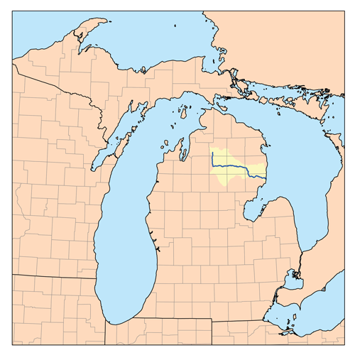
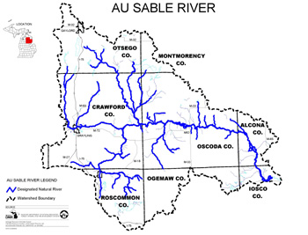
Location of Au Sable River Camping retreat took place on the private property of a friend to the team

Slide 13
Methods-Epidemiologic Investigation
Once details of the retreat were obtained, a case control study was conducted to identify exposures associated with illness
Primary Case Definition-
A primary case was defined as diarrhea (three or more loose stools in a 24-hour period) or (four or more gastrointestinal symptoms [e.g., nausea, abdominal cramps, vomiting, anorexia or fever]) occurring within 12 days of the retreat. Confirmed cases had a positive stool test for Cryptosporidium. Controls attended the retreat but reported no illness.

Slide 14
Methods-Epidemiologic Investigation
Secondary Case Definition-
An individual who did not attend the camping trip and became ill by exposure to an individual who attended the camping trip (person to person exposure).
A probable case was defined as a case that lacked laboratory confirmation but was linked epidemiologically to a confirmed case.
Survey was distributed online, 81 surveys were completed

Slide 15
 | Number or Percentage
Primary Case Attack Rate | 49.4% (40/81)
Primary Cases | 40
Secondary Cases | 7*
Controls | 34
Retreat occurred August 12-13, 2016

Slide 16
Symptoms
Symptoms of Primary Cases | Percentage or Number |  | Symptoms of Primary Cases | Percentage or Number
Diarrhea | 100% (40/40) |  | Nausea | 70% (28/40)
Fatigue | 95% (38/40) |  | Cramps | 70% (28/40)
Loss of appetite | 88% (35/40) |  | Vomiting | 43% (17/40)
Gas/bloating | 75% (30/40)

Slide 17
Age and Gender
Age Group | Primary Cases | Secondary Cases
10-19 yrs. old | 90% (36/40) | 29% (2/7)
20-49 yrs. old | 7.5% (3/40) | 42% (3/7)
50-74 yrs. old | 2.5% (1/40) | 29% (2/7)
Gender of Primary Cases | 100% Male | 57% Male (4/7) 43% Female (3/7)

Slide 18
Health Care Visits and Incubation Period
Healthcare Visits of Primary Cases | Percentage (Number or days)
Primary Care Doctor | 30% (12/40)
Emergency Room | 15% (6/40)
Incubation Period Range and Mean | 169-276 hrs. (4-7 days) Mean = 6 days

Slide 19
Statistical Analysis Results
Association with Illness | Odd Ratio, Confidence Interval, Stat. Significant.
Mud Fight | OR=10.82 CI 3.5-33.6 p=.00003
Swimming in River | OR=4.39 CI 1.5-12.5 p=.008
*analysis of 28 water exposure variables and 32 food exposure variables. Seven stool samples tested positive for the parasite Cryptosporidium.

Slide 20
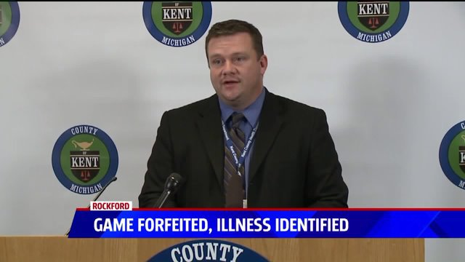
Conclusion
During this investigation, prompt doctor, school, and electronic surveillance reporting led to early identification of the parasite. Disease prevention interventions, including the cancellation of the team’s first game, prevented further transmission.
Adam London, Health Officer

Slide 21
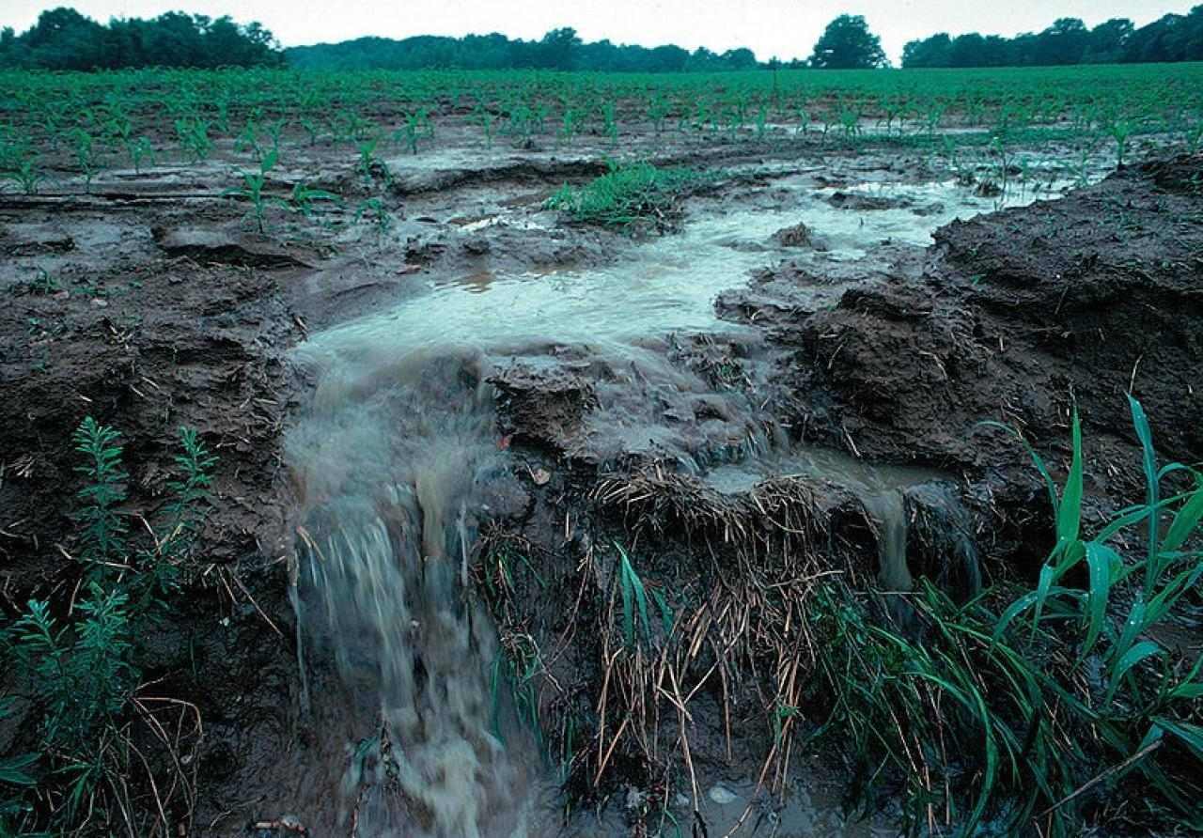
Conclusions
Cryptosporidium is found in river water and is established by pollution.
There were heavy rains in the area prior to the retreat, which potentially introduced the parasite into the river from surrounding fields.
Players rinsed themselves off in the river prior to eating dinner and did not shower or perform proper hand hygiene.

Slide 22
Images
By Slide Number
http://highschoolsports.mlive.com/news/article/2234257689597148235/munger-games-veteran-rockford-football-coach-on-brink-of-career-milestone/
http://www.freeclinics.com/det/mi_49503_kent-county-health-
department-fuller-public-health-clinic
http://www.epodunk.com/cgi-bin/genInfo.php?locIndex=21908
http://www.andersoneconomicgroup.com/Portals/0/Um%20football.j
4. http://media.mlive.com/grpress/news_impact/photo/rockford-grandville-19-b92c1d3fe12ed48d.j
/lintvwood.files.wordpress.com/2016/08/generic-rockford-high-school-%20football.jpg
image.jpghttps://www.cdc.gov/parasites/crypto/
8. https://lintvwood.files.wordpress.com/2016/08/rockford-high-school-inspection- 082516.jpg
9. http://woodtv.com/2016/08/26/kchd-30-in-rockford-football-program-likely-have-crypto/
11. https://upload.Wikimedia.org/Wikipedia/commons/4/40/Canoes_AuSableRiverMI.jpg
12. https://en.wikipedia.org/wiki/Au_Sable_River_(Michigan)
http://www.michigan.gov/images/au_sable1a_19270_7.jpg
20. http://fox17online.com/2016/08/26/parasite-identified-in-rockford-varsity-football-
team-illnesses/
21. http://fmr.org/sites/default/files/styles/1280w/public/field/image/farm-runoff.jpg?itok=C1hLVf-1

