Slide 1
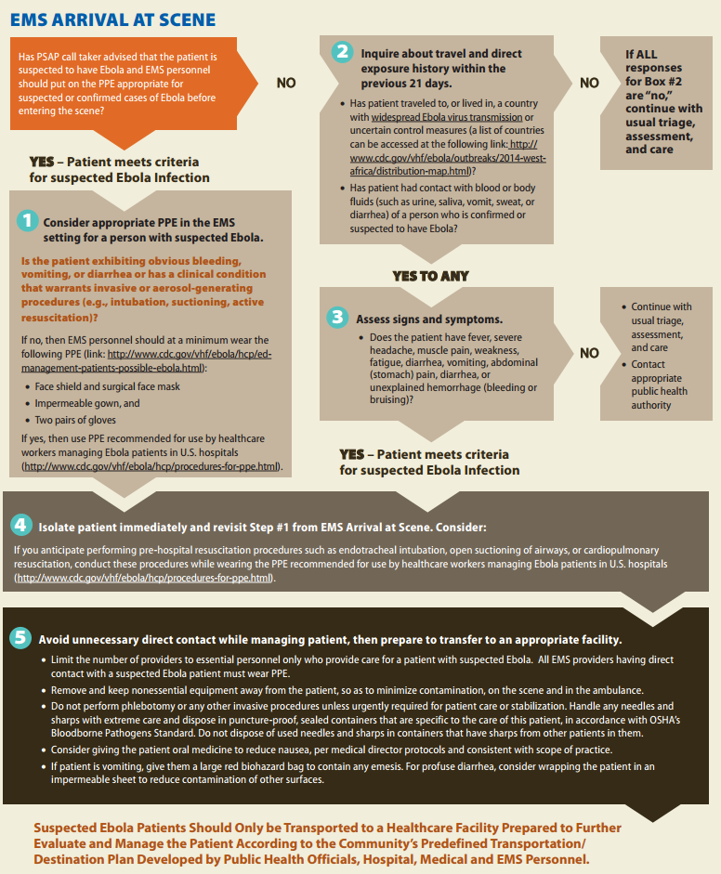
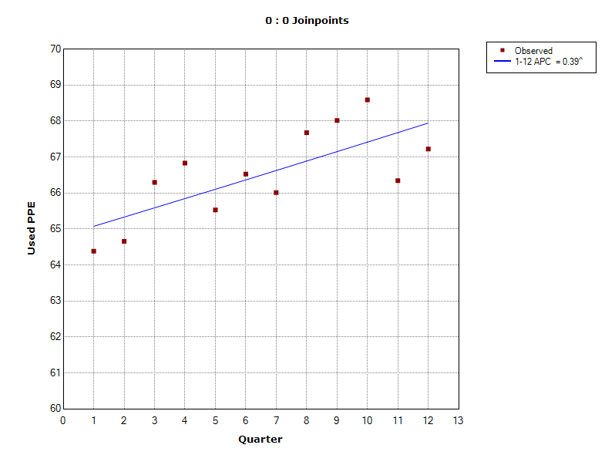
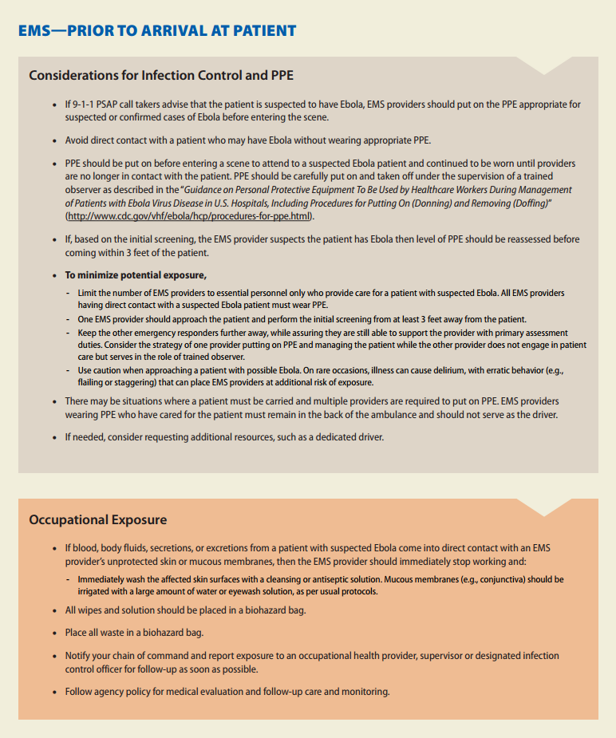
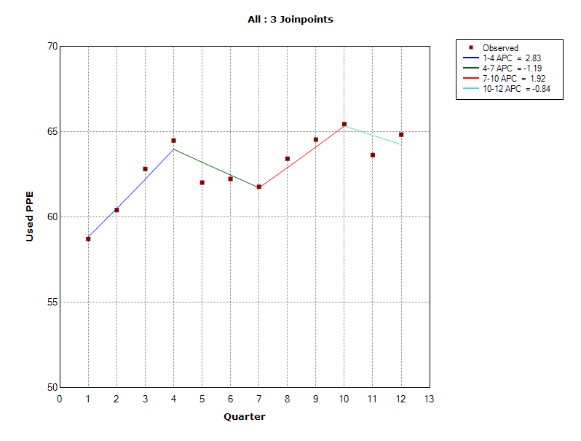
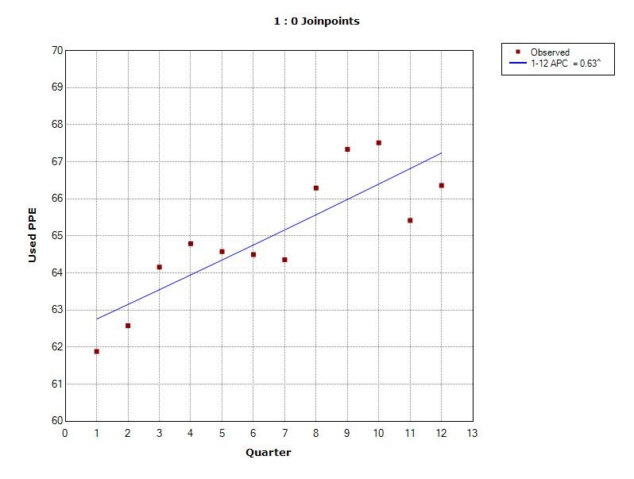
Using Emergency Medical Services (EMS) Data to Assess Personal Protective Equipment Reporting by Illinois EMS Providers in Response to the 2014–2016 Ebola Outbreak in West Africa
Livia Navon^{1,2} , Daniel Lee¹, and Lisa Diep³
1. Illinois Department of Public Health 2. Division of State and Local Readiness, Office of Public Health Preparedness and Response, CDC 3. University of Illinois at Chicago, School of Public Health
Background
During the 2014–2016 Ebola Outbreak in
West Africa, and the subsequent arrival of
travelers to the U.S., CDC issued guidance
for EMS providers regarding use of personal
protective equipment (PPE)
EMS providers in Illinois report data on
each ambulance run to the Illinois
Department of Public Health
including PPE utilized on each run
We examined ambulance run data to determine if during the time of heightened concern regarding domestic Ebola transmission (October 2014–June 2015), PPE utilization increased, particularly among patients with infectious symptoms compared to patients with non-infectious symptoms
Figure 1. Exclusion Criteria and Data Included in Each Analysis
Figure 3. Trend Analysis of Reported PPE Use for Patients with Non-Infectious Symptoms, Illinois, 2013–2015
Total Ambulance Runs
2,916,556 (100%)
Exclusion Criteria
Ambulance run cancelled, no patient found, patient refused care, no treatment required
271,586
Eligible Runs
2,644,970 (90.7%)
Runs by agencies who always reported PPE usage or never reported PPE usage
469,056
Eligible Runs + Reporting Agency Reported Variation in PPE Usage
2,175,914 (74.6%)
(Figure 2)
Symptoms missing, none, not applicable, not available, not known, not recorded or not reporting
764,880
Eligible Runs + Reporting Agency Reported Variation in PPE Usage + Symptom Information
1,411,034 (53.3%)
(Figures 3 and 4)
Methods
  Illinois EMS data ambulance run data from January 1, 2013–December 31, 2015 were included in this analysis
  Patients were classified as infectious or non-infectious based on primary symptoms reported by EMS providers
  JoinPoint regression software (available from the National Cancer Institute) was used to examine trends in self-reported PPE provider use by quarter
2013
2014
2015
^The Annual Percent Change (APC) is significantly different from zero at alpha=0.05
Figure 2. Trend Analysis of Reported PPE Use, Patients with Any Symptoms, Illinois, 2013–2015
Figure 4. Trend Analysis of Reported PPE Use for Patients with Infectious Symptoms, Illinois, 2013–2015
Limitations
Data was missing for a large percentage of ambulance runs
Results
  496 different EMS agencies entered 2,644,970 eligible runs into the statewide EMS system (range: 1–699,235 ambulance runs per agency) with a median of 1,331 runs per agency (Figure 1)
  41% of eligible ambulance runs had no PPE use reported (PPE field was either marked as no applicable (20.2%), not available (8.1%), not known (0.01%), not recorded (2.4%) not reporting (0.84%) or left blank (9.3%)
  EMS agencies that reported no variation in PPE usage were excluded (54 agencies reported no PPE usage and 45 agencies reported PPE usage for each run). These runs represented 17.6% of eligible runs (Figure 1)
  We first analyzed the trend in reported PPE use not accounting for patient symptoms. Although there was an increase during the time of heightened Ebola concern, this increase was not statistically significant (Figure 2)
  We refined this analysis to take into account infectiousness of patient symptoms (Table 1). Data were excluded if patient primary symptoms were either missing or marked as not reported, not available, not known, not recorded or not reporting (28.7% of eligible runs)
  On ambulance runs with non- infectious patients, the modeled average percent change (APC) increase in PPE use was 0.39% per quarter (p<0.05). No breaks in trend were statistically significant (Figure 3).
  On ambulance runs with infectious patients, the APC was 0.63% per quarter (p<0.05). No breaks in trend were statistically significant (Figure 4).
Slope not
significant
2013
2014
2015
2013
2014
2015
Table 1. Categorization of Patient Primary Symptoms as Infectious and Non-Infectious, Ambulance Runs, Illinois, 2013–2015
^The Annual Percent Change (APC) is significantly different from zero at alpha=0.05
Conclusions
  Use of PPE increased linearly from January 2013–December 2015 for patients with infectious and non-infectious symptoms with a higher APC for infectious patients
  There were no statistically significant breaks in the linear trend corresponding to the time of heightened concern about the 2014–2016 Ebola Outbreak in West Africa, despite a slight increase in reported PPE use during October 2014–June 2015
Recommendations
Changes to the Illinois EMS PPE reporting system are needed to better capture use of PPE and patient symptoms by EMS providers
Education of EMS providers on importance of complete data capture may improve data quality
Infectious |  | Non-Infectious
Primary Symptom | Number of Runs | Primary Symptom | Number of Runs
Malaise | 67,167 | Pain | 478,773
Bleeding | 64,209 | Change in responsiveness | 208,229
Nausea/Vomiting | 38,341 | Breathing Problem | 162,831
Fever | 23,107 | Weakness | 125,221
Drainage/Discharge | 9,177 | Mental/Psych | 123,793
Diarrhea | 8,167 | Transport Only | 41,527
Rash/Itching | 5,685 | Swelling | 17,877
 |  | Wound | 14,866
 |  | Death | 10,760
 |  | Palpitations | 6,869
 |  | Choking | 1,873
 |  | Device/Equipment Problem | 1,401
 |  | Mass/Lesion | 1,221
Total | 215,793 | Total | 1,195,241

