Slide 1
Demographic and travel characteristics of Travel-associated Zika virus infection cases in San Diego County, California, January 1 2016 to march 31 2017
Gabriela Escutia, MPH
CSTE Applied Epidemiology Fellow
CSTE 2017 Conference
June 5, 2017

Slide 2
Disclaimer
The findings and conclusions in this report are those of the authors and do not necessarily represent the official position of the Centers for Disease Control and Prevention or County of San Diego Health and Human Services Agency.

Slide 3
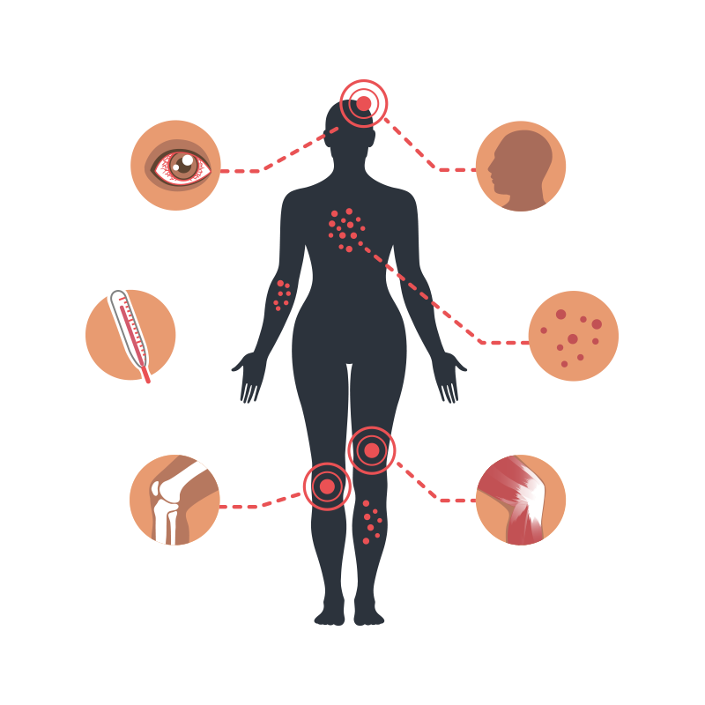
background
What is Zika Virus?
Flavivirus spread to people primarily through the bite of an infected Aedes species mosquito (Ae. aegypti and Ae. albopictus)
Sexual and congenital transmission
80% have no symptoms
Symptoms usually mild
Linked to birth defects (microcephaly)
and Guillain-Barré syndrome
No treatment or licensed vaccines

Slide 4
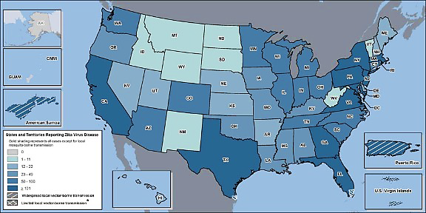
Continental US States with ZIKV Cases, 2015-2017
~ 527
78
Total as of 5/17/2017: US States = 4,949
Total as of 3/31/2017: San Diego County = 78
Sources: CDC, CDPH. Downloaded 5/17/17 from: https://www.cdc.gov/zika/reporting/2017-case-counts.html
https://archive.cdph.ca.gov/HealthInfo/discond/Pages/Zika.aspx

Slide 5
ZIKV Epidemiological Surveillance
ZIKV infection: A NATIONAL reportable condition
ArboNET: National surveillance system for arboviral diseases in the United States
Demographic and travel information collected: Age, gender, race/ethnicity, country of birth, country of travel
Information not collected: Language, reason for travel, and travel duration
Information is needed to guide culturally and linguistically targeted public health interventions

Slide 6
Objectives
To describe demographics, travel patterns, and other characteristics among travel-associated Zika virus (ZIKV) infection cases in San Diego County
To compare San Diego County travel-associated ZIKV cases by reason of travel

Slide 7

Methods
San Diego County Epidemiology Program
As of February 2016, enhanced completeness of demographic variables for travel-associated ZIKV cases
Added questions to surveillance form: travel duration and reason for travel (tourism, visiting friends and relatives (VFRs), business or study)
Trained epidemiology staff
Weekly database quality assurance for completeness

Slide 8

Analysis
Confirmed* and probable* San Diego County travel-associated ZIKV cases were reviewed by country of travel information
Episode month**: January 1, 2016 to March 31, 2017
Univariate analysis
Bivariate analysis*** by:
Race/Ethnicity
Gender
Country of birth
Purpose of travel
SPSS Version 24
* CSTE case definitions
** Episode month: the month of symptom on set or earliest available date (specimen collection month or month case was reported)
*** χ2 test and Freeman-Halton Exact Test

Slide 9
Results
San Diego County ZikV cases
by episode month (n=78)
*Cases extracted from system March 31 2017( Last episode month for confirmed and probable cases was January 31 2017)

Slide 10
Results
ZIKV CASES BY SEX AND RACE/ETHNICITY (N=78)

Slide 11
results
Percentage of ZikV Cases by Race/Ethnicity
compared to San Diego County population* (N=78)

Slide 12
Results
ZIKV CASES BY race/ethnicity AND Language of the interview (n=78)

Slide 13
results
Percentage of ZikV cases
by Gender and selected Race/ethnicity
Compared to san Diego county population*

Slide 14
Results
women (n=43) by pregnancy status
Pregnant Women by Race/ Ethnicity
Group | n
Hispanic | 4
Asian | 2
Total | 6

Slide 15
Results
foreign-born (n=26) ZiKV cases versus
San Diego County Foreign-born population*
‡
‡ p-value=0.039
*U.S. Census Bureau, 2015 American Community Survey 1-Year Estimates

Slide 16
Results
ZIKV cases by region of birth
and Region of travel
Region of travel
 | Mexico | Central America | South America | Caribbean | Other
US-born | 13 | 15 | 2 | 13 | 4
Mexico | 14 | 0 | 0 | 0 | 0
Central America | 0 | 4 | 0 | 0 | 0
South America | 1 | 0 | 3 | 0 | 0
Caribbean | 0 | 0 | 0 | 1 | 0
Other | 0 | 0 | 0 | 0 | 3
Region of birth

Slide 17
Results
ZIKV cases by reason for travel

Slide 18
results
ZIKV cases by Ethnicity, nativity and purpose of travel
 | Nativity |  | Purpose of Travel
Ethnicity | Foreign-born** n(%) | US-Born n(%) | VFRs** n(%) | Non-VFRs n(%)
Hispanic | 22 (56) | 17(44) | 20(51) | 22(49)
Non-Hispanic | 4 (12) | 30(88) | 8(23) | 28(77)
** P-value < 0.05

Slide 19
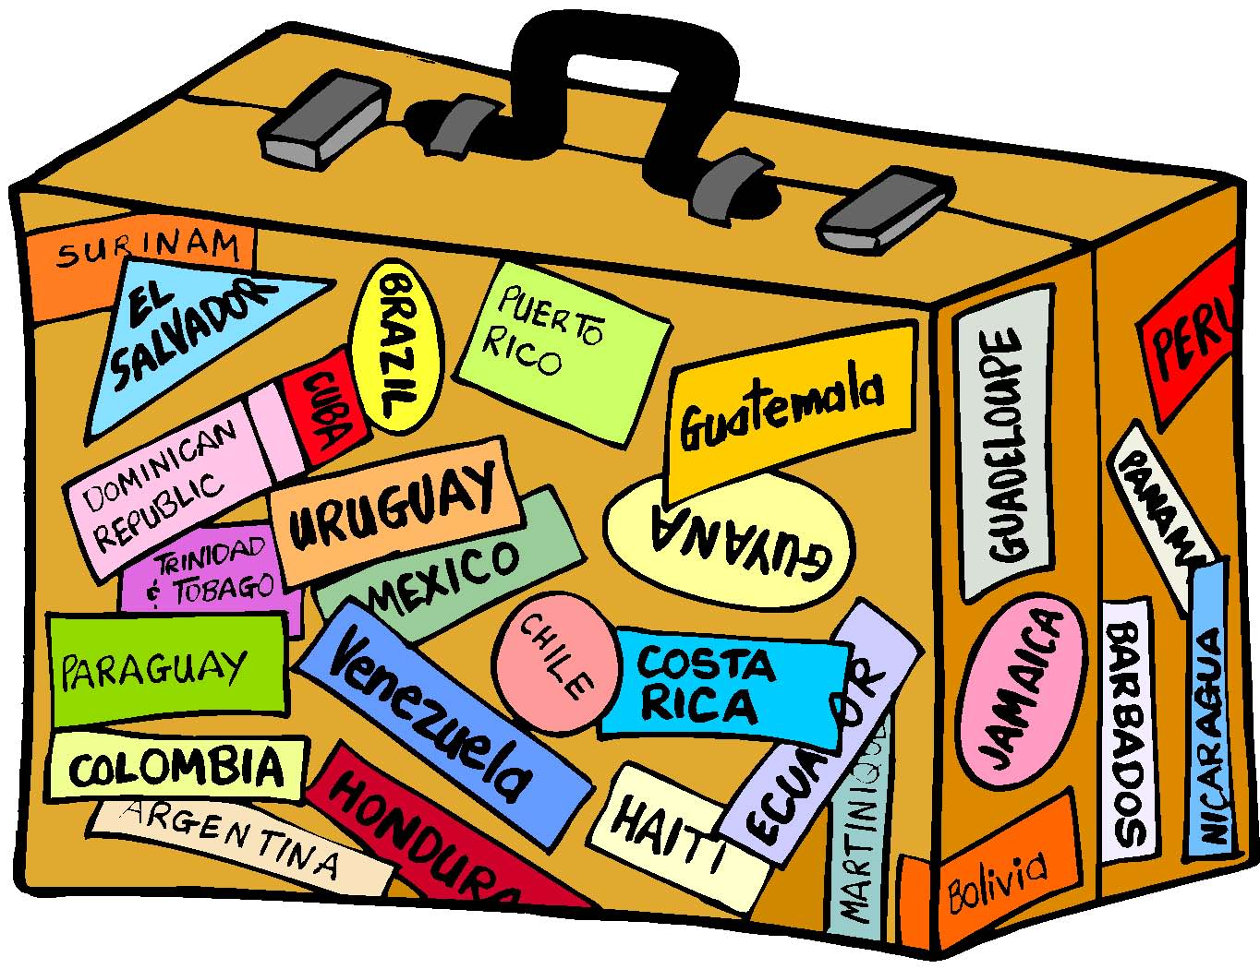
Results
Median Travel duration (days)
by purpose of travel (N=73)
8 days
1 | 2 | 3 | 4 | 5 | 6 | 7 | 8
10 days
Non-VFRs*
1 | 2 | 3 | 4 | 5 | 6 | 7 | 8 | 9 | 10
VFRs*
*p-value=0.03
Note: 3 cases with missing data; 2 cases excluded (cases resided outside US before diagnosis)

Slide 20
Limitations
Information on travel frequency and patterns among the San Diego County resident population was unavailable for this analysis and thus no assessment of ZIVK infection risk can be inferred from this study
Results might be different in other US geographical areas due to differences in population demographics and travel patterns
Surveillance data used may not be representative of all infected travelers, as not all seek medical care or are tested for ZIKV infection

Slide 21
Discussion
The majority ZIKV cases in San Diego County were in Hispanics, particularly Hispanic women
Hispanic ZIKV cases were more likely to be foreign-born, VFR travelers and travel to their region of origin
ZIKV cases were more likely to be foreign-born than US-born when compared to overall foreign-born population
Enhanced collection and analysis of demographics and travel-associated information is needed to identify populations at need for targeted public health interventions
Continuous culturally and linguistically appropriate outreach and education is needed for Hispanic travelers in San Diego County

Slide 22

Co-authors
Acknowledgments
Eric McDonald, MD, MPH
Alfonso Rodriguez Lainz, PhD
Jessica Healy, PhD
I would like to express my gratitude to Kristen Angel, MPH, for her contribution to the review of cases and the San Diego County Epidemiology program staff for their assistance on enhancing data collection.
This project was supported, in part by an appointment to the CSTE Applied Epidemiology Fellowship program, administered by the Council of State and Territorial Epidemiologists (CSTE) and funded by the Centers for Disease Control and Prevention (CDC) Cooperative Agreement Number 1U38OT000143-03.

Slide 23

Open discussion
THANK YOU

