Slide 1



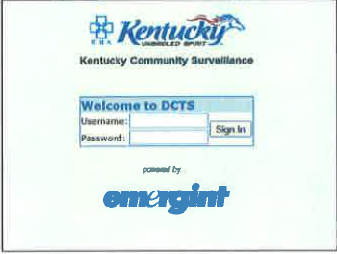
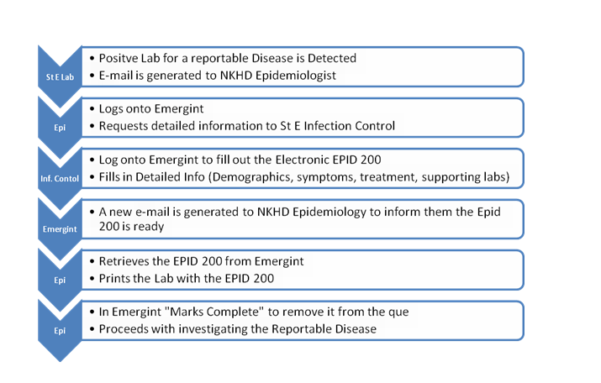
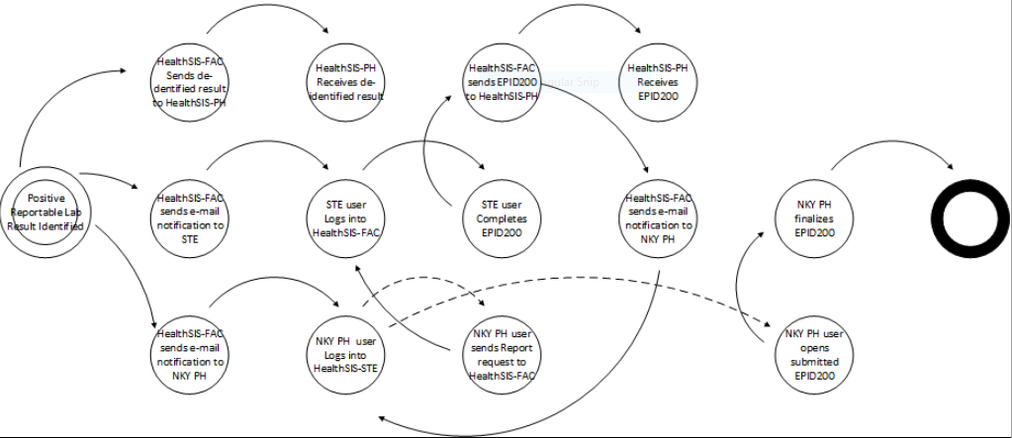
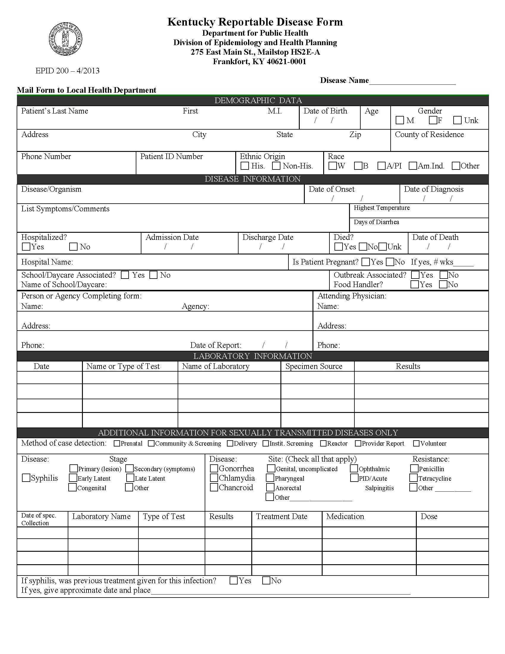
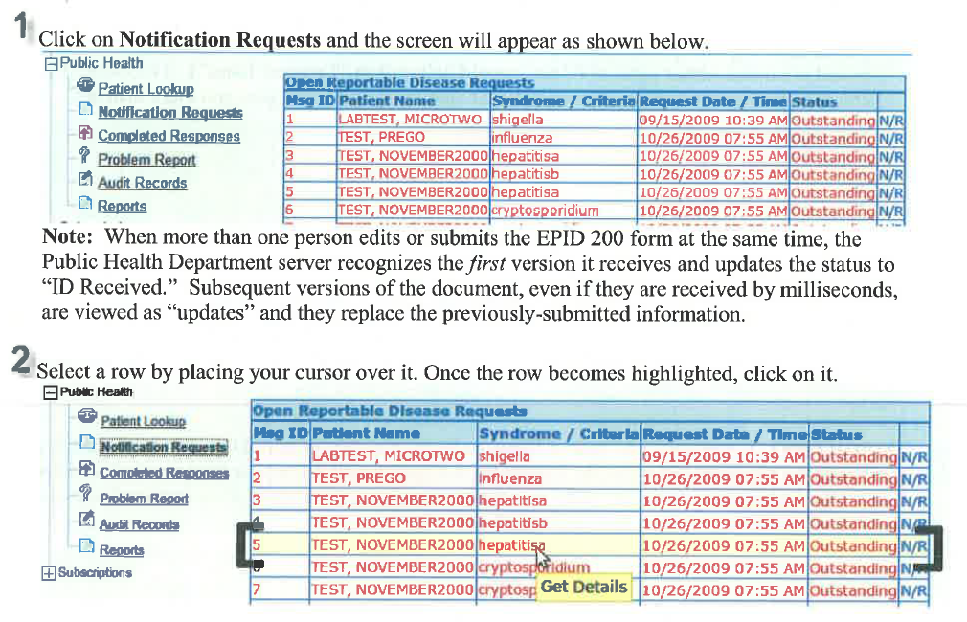
Streamlining Reportable Disease Surveillance: Utilizing an Alerts-Based Surveillance System to Extract Data from a Regional Hospital for Automatic Disease Reporting to a District Health Department in Northern Kentucky Ekaette Joseph-Isang¹, Douglas A. Thoroughman², Kelly Giesbrecht³, Marzieh Hatamzadeh⁴, Sara Robeson¹ and Joyce Rice³ (1)Kentucky Department for Public Health, (2)Centers for Disease Control and Prevention (CDC), (3)Northern Kentucky Independent District Health Department, (4)Northern Kentucky University)
BACKGROUND
System Overview
HealthSIS Work Flow
6.0
Results
In 2009, the Northern Kentucky Independent District Health Department, in partnership with St. Elizabeth’s Hospital, began using a proprietary surveillance system called Emergint (now HealthSiS) (figure 1)
System supports direct disease reporting from the hospital’s electronic health records (EHR) and laboratory information management system (LIMS) to the public health department.
EHR and LIMS data streams are monitored by HealthSiS, and positive laboratory results trigger an e-mail alert to both hospital infection control staff and district health department staff prompting them to access the system and review new cases.
The system partially populates Kentucky’s EPID 200 Reportable Disease Form electronically (figure 2) reportedly saving more than 50% of workers’ time compared to paper-based reporting.
HealthSiS pre-populates the Epid 200 Reportable Disease Form with editable demographic information from the electronic health record and the laboratory result saving staff time.
The system abstracts information with 100% accuracy from hospital and laboratory records, but only 50% of the form is populated necessitating further manual data entry.
Disease-reporting time was reduced from 15 minutes per case in the paper-based system to about one minute, saving more than 50% reporting time.
Conclusion
Figure 3
When efficiently implemented, automated disease reporting from EHR to state system reduces workload.
The alerting function provides time-savings and reduces reportable disease processing turn around time by instantly notifying end-users when cases are available for review. (figure 5)
This alerting functionality can be tested in other surveillance systems and potentially incorporated into the state Health Information Exchange (HIE), creating an opportunity to utilize the HIE as a surveillance system.
Figure 1
Reportable Disease Form
OBJECTIVES
To describe HealthSiS, an electronic reportable disease surveillance system, which provides time-savings to end-users via its alerting functions
Limitations
The system which was initially deployed across three health departments, is currently in use by one health department and does not cover all the reportable diseases in Kentucky.
All conditions reportable in Kentucky are not available via HealthSIS.
METHODS
Figure 4
Evaluation period: May 2016 to August 2016.
Open-ended interview questions, administered to system end-users and the system developers were tailored according to the Centers for Disease Control and Prevention’s (CDC) guidelines for evaluating surveillance systems were. (MMWR, 2013).
Other questions focused on options for interoperability and system integration.
Comparison between electronic and paper system times spent on automated disease reporting, the advantages of the system, ease of utilization and data completeness were made between HealthSIS and the former paper process.
Screenshot Showing Alerts
Figure 5
References
Guidelines for evaluating surveillance systems available at: https://www.cdc.gov/mmwr/preview/mmwrhtml/00001769.htm and retrieved April 19, 2017
Stephen B. Thacker, Donna F. Stroup; Future Directions for Comprehensive Public Health Surveillance and Health Information Systems in the United States. Am J Epidemiology 1994; 140 (5): 383-397. doi: 10.1093/oxfordjournals.aje.a117261
Health Surveillance Information System (HealthSiS) User Guide
Figure 2
“This study/report was supported in part by an appointment to the Health Systems Integration System Program administered by CSTE and funded by the Centers for Disease Control and Prevention (CDC) Cooperative Agreement 3U38-OT000143-01S4.”

