Slide 1




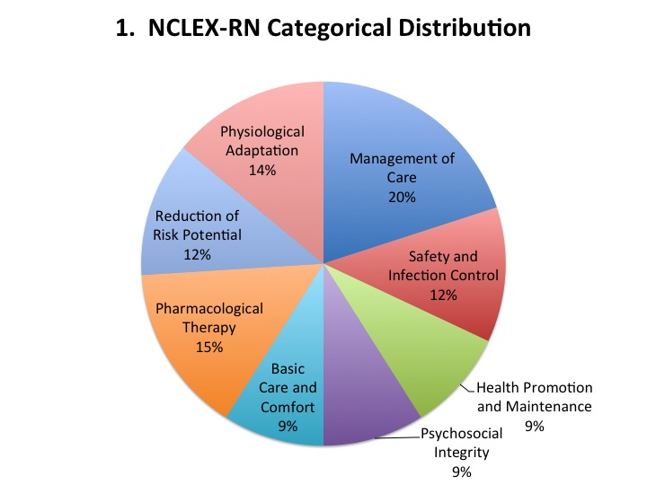
Infection Control Educational Content in Nursing and Allied Health Schools in Nebraska
￼
Madison Sullivan, Public Health Associate, CDC; Maureen R. Tierney MD, MSc. Director, HAI Program, Nebraska DHHS
BACKGROUND
Currently in Nebraska there is limited guidance for pre-professional programs on what should be taught in infection control curriculums. Programs typically teach to what they believe will be asked on the licensure exams.
The objective was to determine the time spent and content of infection prevention instruction in nursing school and allied health curricula.
METHODS
Nursing
A request was sent to 36 nursing programs for a description of their infection prevention content for the 2016-2017 school year
Responses were received from 28 programs; 13 unique nursing schools
Degrees included
Bachelors of Science in Nursing (BSN)
Masters of Science in Nursing (MSN)
Licensed Practical Nursing (LPN)
Associates Degree in Nursing (AND)
Registered Nursing (RN)
Allied Health
60 allied health programs were surveyed on their infection control curriculum
Responses were received from 20 programs; 8 unique schools. Information was sought on the time spent and content of instruction of
hand hygiene,
Personal Protective Equipment (PPE) use,
antibiotic resistance,
injection safety,
HAI prevention, and
knowledge of resources
The allied health programs that were surveyed included:
dentistry, dental hygiene, physicians assistant,
medical laboratory technician,
occupational therapy, and
physical therapy
RESULTS
CONCLUSIONS
Nursing
BSN and LPN/AND programs provided the most in depth IP curriculum by description content
Range of 0-31 hours
Average of 12.57
Common theories of practice with ranges:
Hand hygiene (0-2 hours)
Transmission precautions (0-3 hours)
Sterilization (0-1 hour)
We found an extensive range of time and IP topics presented to students in nursing and allied health programs.
A survey of Chief Nursing Officers will be performed to assess where they see gaps in the IP education of new hires
Based on the results of this project and the CNO survey a pilot project of interventions will be applied to the IP curriculum in nursing programs
The Nebraska Nursing Deans and Directors Association is partnering with DHHS to work towards the most effective interventions
Once the effectiveness of these interventions has been determined, similar programs will be applied to allied health IP curricula.
Allied Health
Range of 0 to 45 hours overall on IC
Average 30 hours
A lack of time was found on three major subjects
Injection safety
Hazmat and bioterrorism
Antibiotic resistance
In comparison to the three common theories of practice listed above, allied health reported higher averages of time spent during their curriculum for all three:
http://calstate.fullerton.edu/news/Inside/2010/photos/nursing-students2.jpg
Each Nurse is required to take their professions version of the National Council Licensure Examination (NCLEX) e.g. NCLEX-RN, NCLEX-PN to become a certified nurse.
Infection Control is about 12% of this exam
60% of todays healthcare workforce is comprised of Allied Health professionals
References
University of Nebraska Medical (2017, April 4) Center. College of Allied Health. Retrieved from https://www.unmc.edu/alliedhealth/about/index.html
National Council of State Boards of Nursing.(2017, April 4) NCSBN. Retrieved from https://www.ncsbn.org/nclex.htm
Dogra, S. Jad, B. Mahajan, B. Mahajan, R. (2015). Educational interventions to improve knowledge and skills of interns toward prevention and control of hospital-associated infections. International Journal of Applied Basic Medical Research (54-57).
Sanchez, E. Drumright, L. Gharbi, M. Farell, S. Holmes, A. Mapping Antimicrobial Stewardship in Undergraduate Medical, Dental, Pharmacy, Nursing and Vterinary Education in the United Kingdom. Plos One.
Nursing Infection Control Education Network; CDC, ANA
Nebraska Nursing Deans and Director Association

